Slide 1
“Books for the Young”: Digital Humanities Approaches to Decoding the Canon
Dr. Rebekah Fitzsimmons
Georgia Institute of Technology (Carnegie Mellon come August)
@DrFitzPhD
Rebekah.Fitzsimmons@lmc.gatech.edu
RebekahFitzsimmons.com ← Slides posted here

Slide 2
Plan for Presentation
Background on DH Project: Hewins “Books for the Young” (1882)
Brief Intro to Stylometrics
Analysis
Next steps

Slide 3
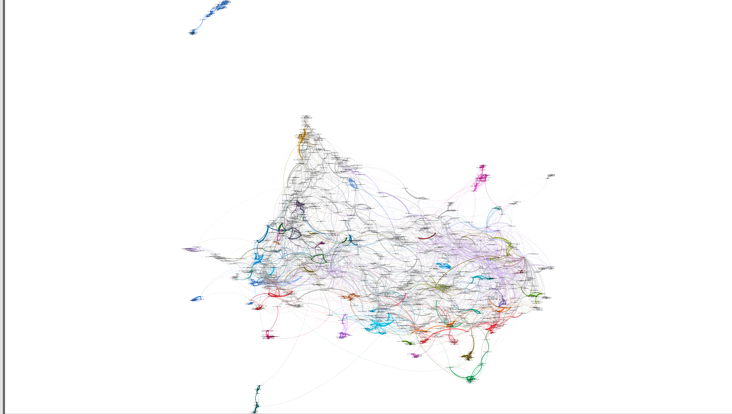
NETWORK ANALYSIS OF HEWINS CORPUS

Slide 4
1.
Backstory
Stumbling into Digital Humanities

Slide 5
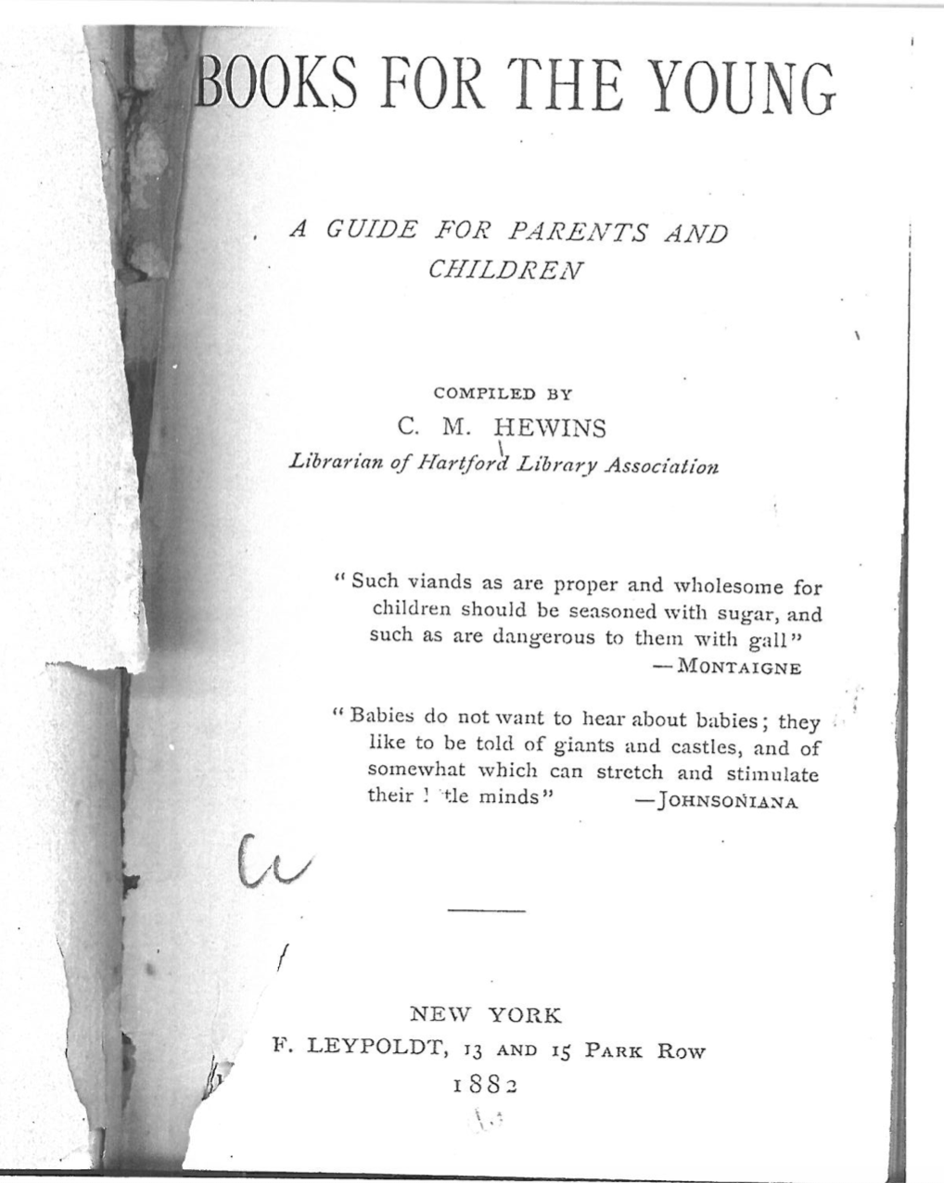
Caroline Hewins’s
“Books for the Young”
1882
2017 CHLA Presentation Available at
RebekahFitzsimmons.com

Slide 6
Compiling a Corpus: 2 Year Process
Locate machine readable texts
  HathiTrust, Project Gutenberg , Archive.org
  Negotiate contract with Google for access
Download texts
Format texts
Learn stylometrics
Learn R and Gephi
Run analysis, make pretty pictures
Interpret and write paper

Slide 7
My Digital Humanities Heroes
Jan Rybicki
Joanna Byszuk
Steve Hodges and GATech DILAC
Ximin Mi and GATech Libraries
Former WCP Interns Albert Lee and Sarah Hayes

Slide 8
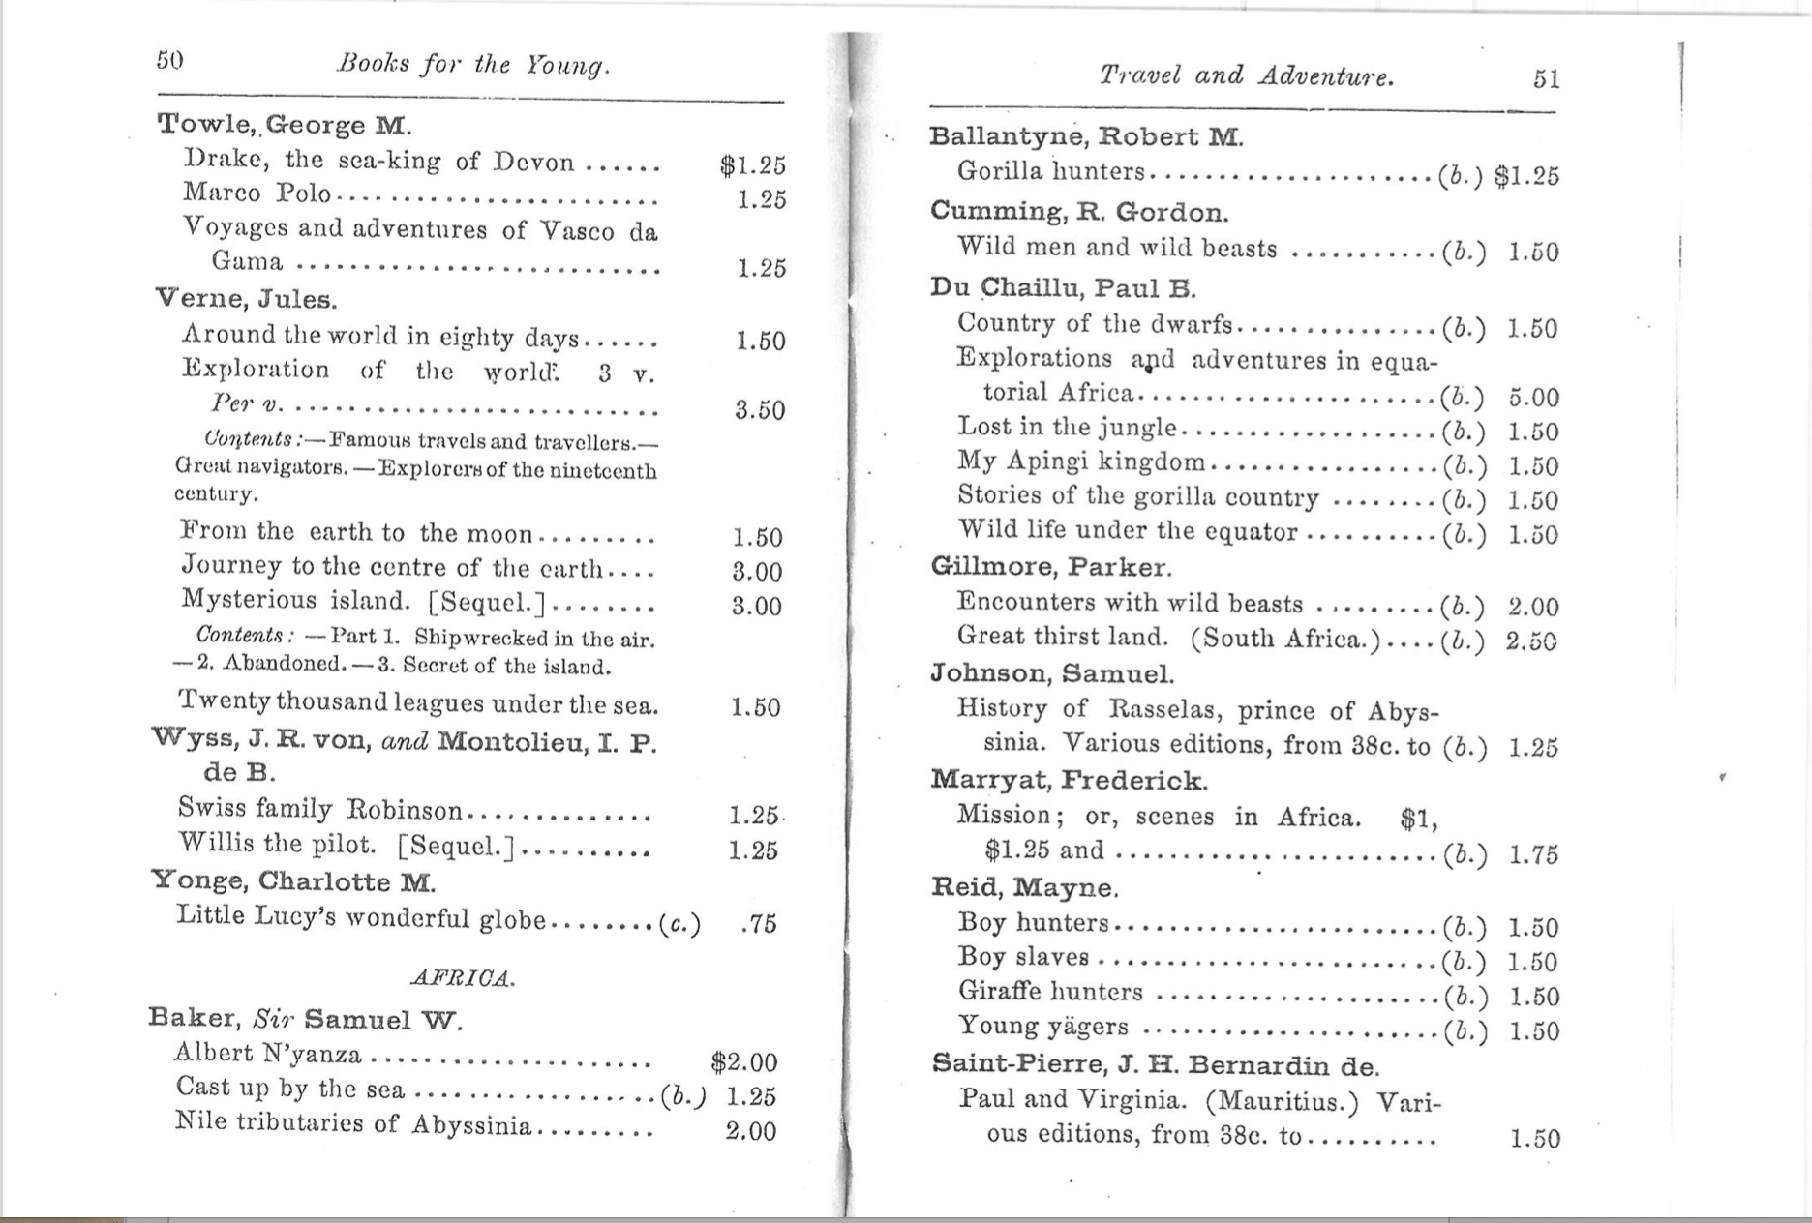

Slide 10
2.
Stylometrics
Using big data for distant readings

Slide 11
Stylometric Analysis
Counting all the words in a given text or corpus
Most Frequent Word list (MFW)
Function or Stop words – articles, pronouns, prepositions
  PERCENT of language
  Fingerprints of an author in the stop words

Slide 12
DH TOOLS
Do not replace close reading or other literary methods; give us new places to look, new ways to see patterns

Slide 13
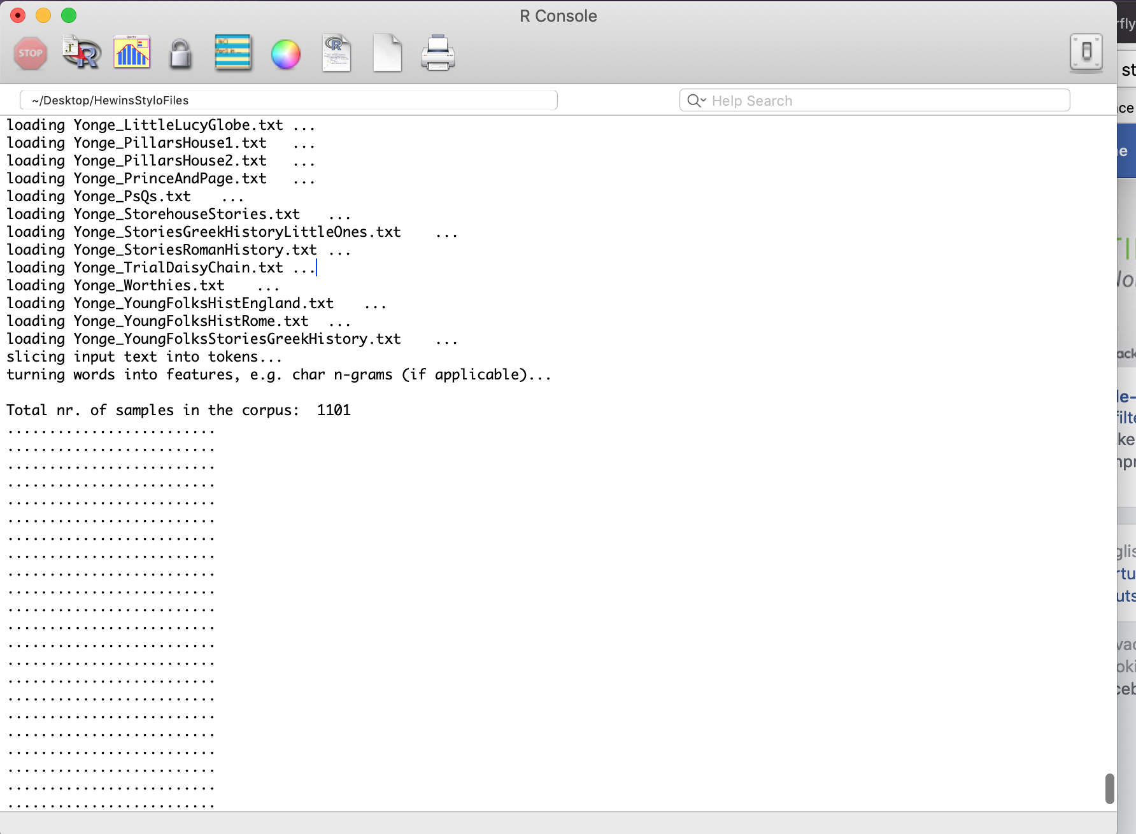
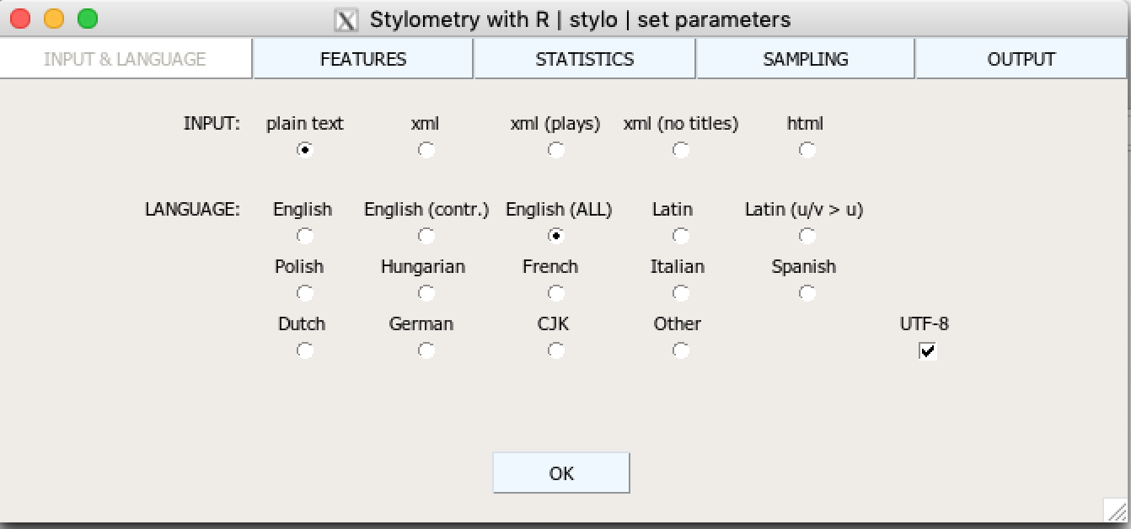

Slide 14
We get an algorithm and feed it a lot of information about our novels and ask it to group the novels into clusters based on how similar they are to each other. We measure similarity in this case based on a set of variables or features.
Jockers, M. Macroanalysis pg 70

Slide 15
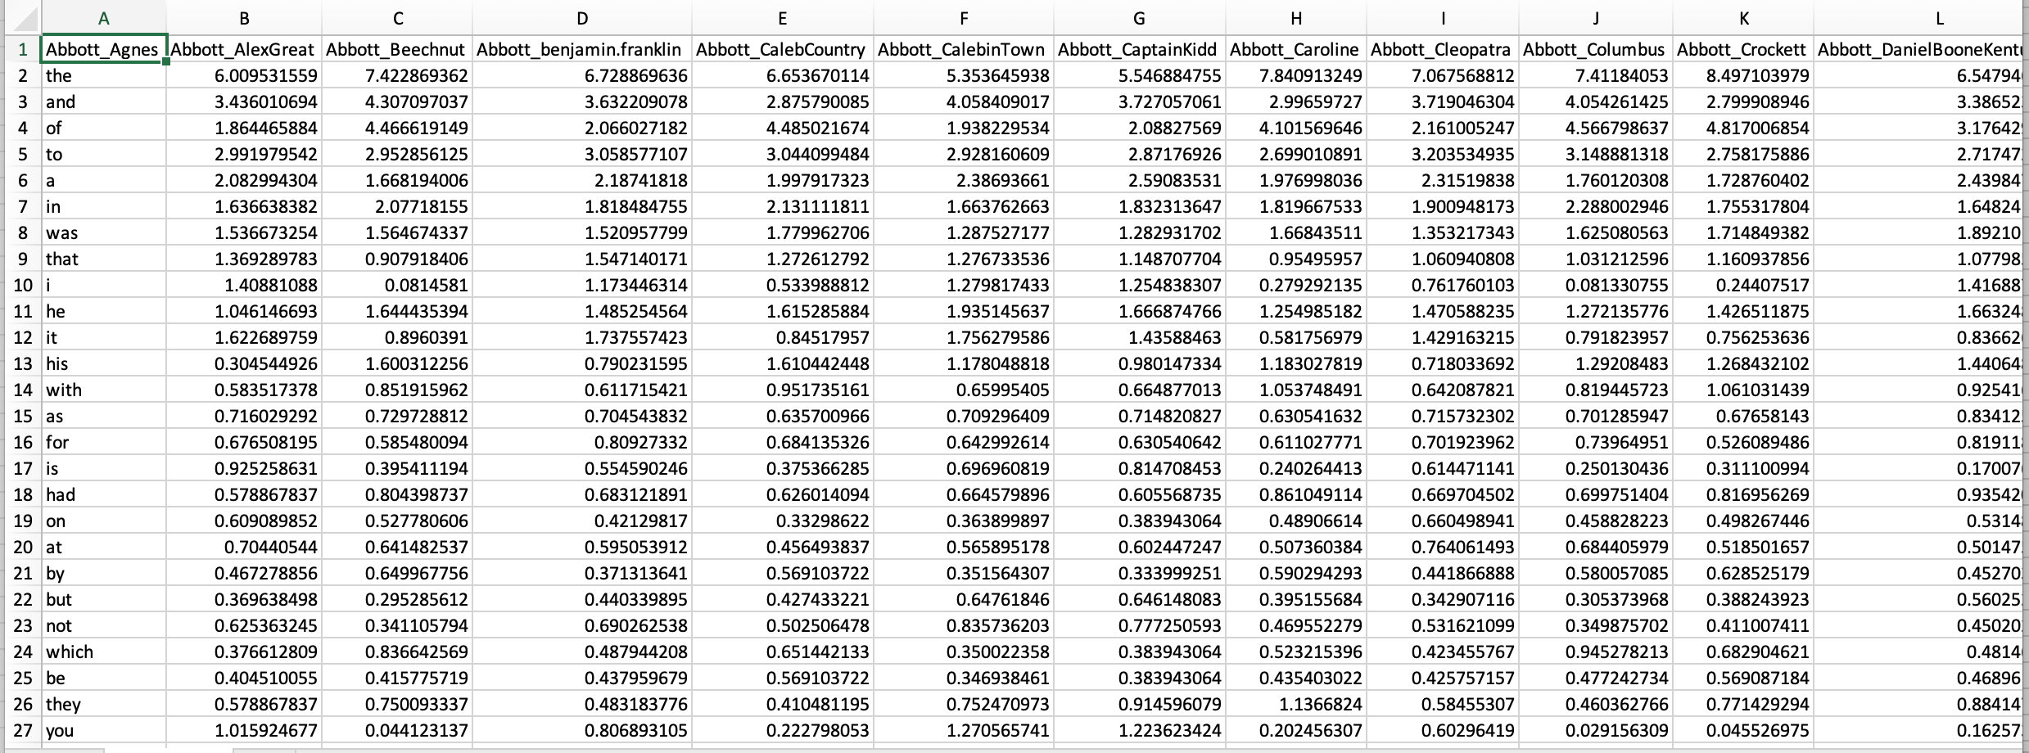
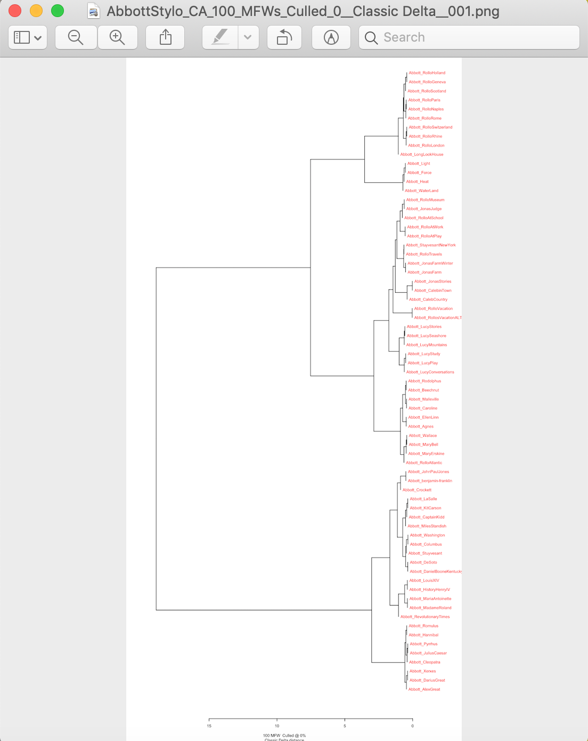

Slide 16
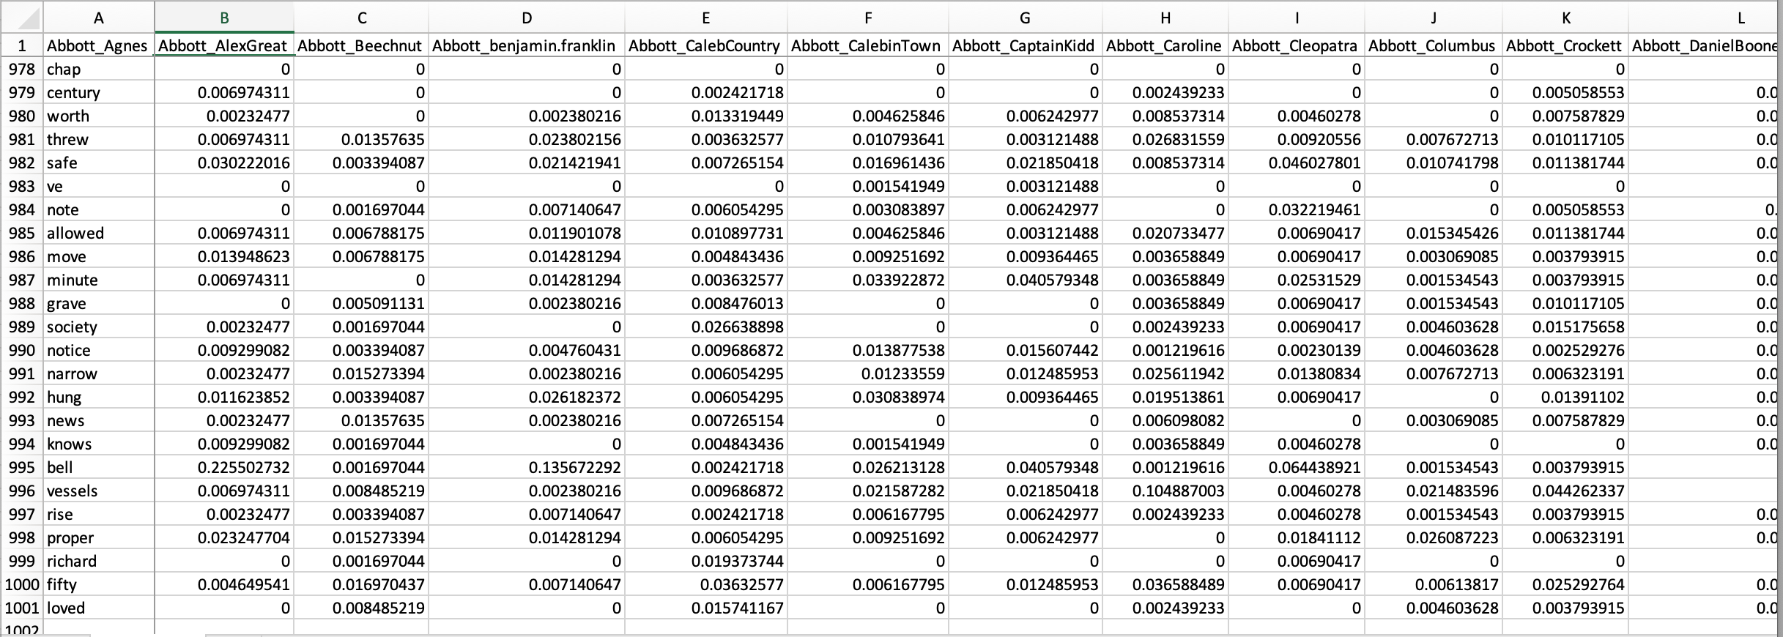

Slide 17
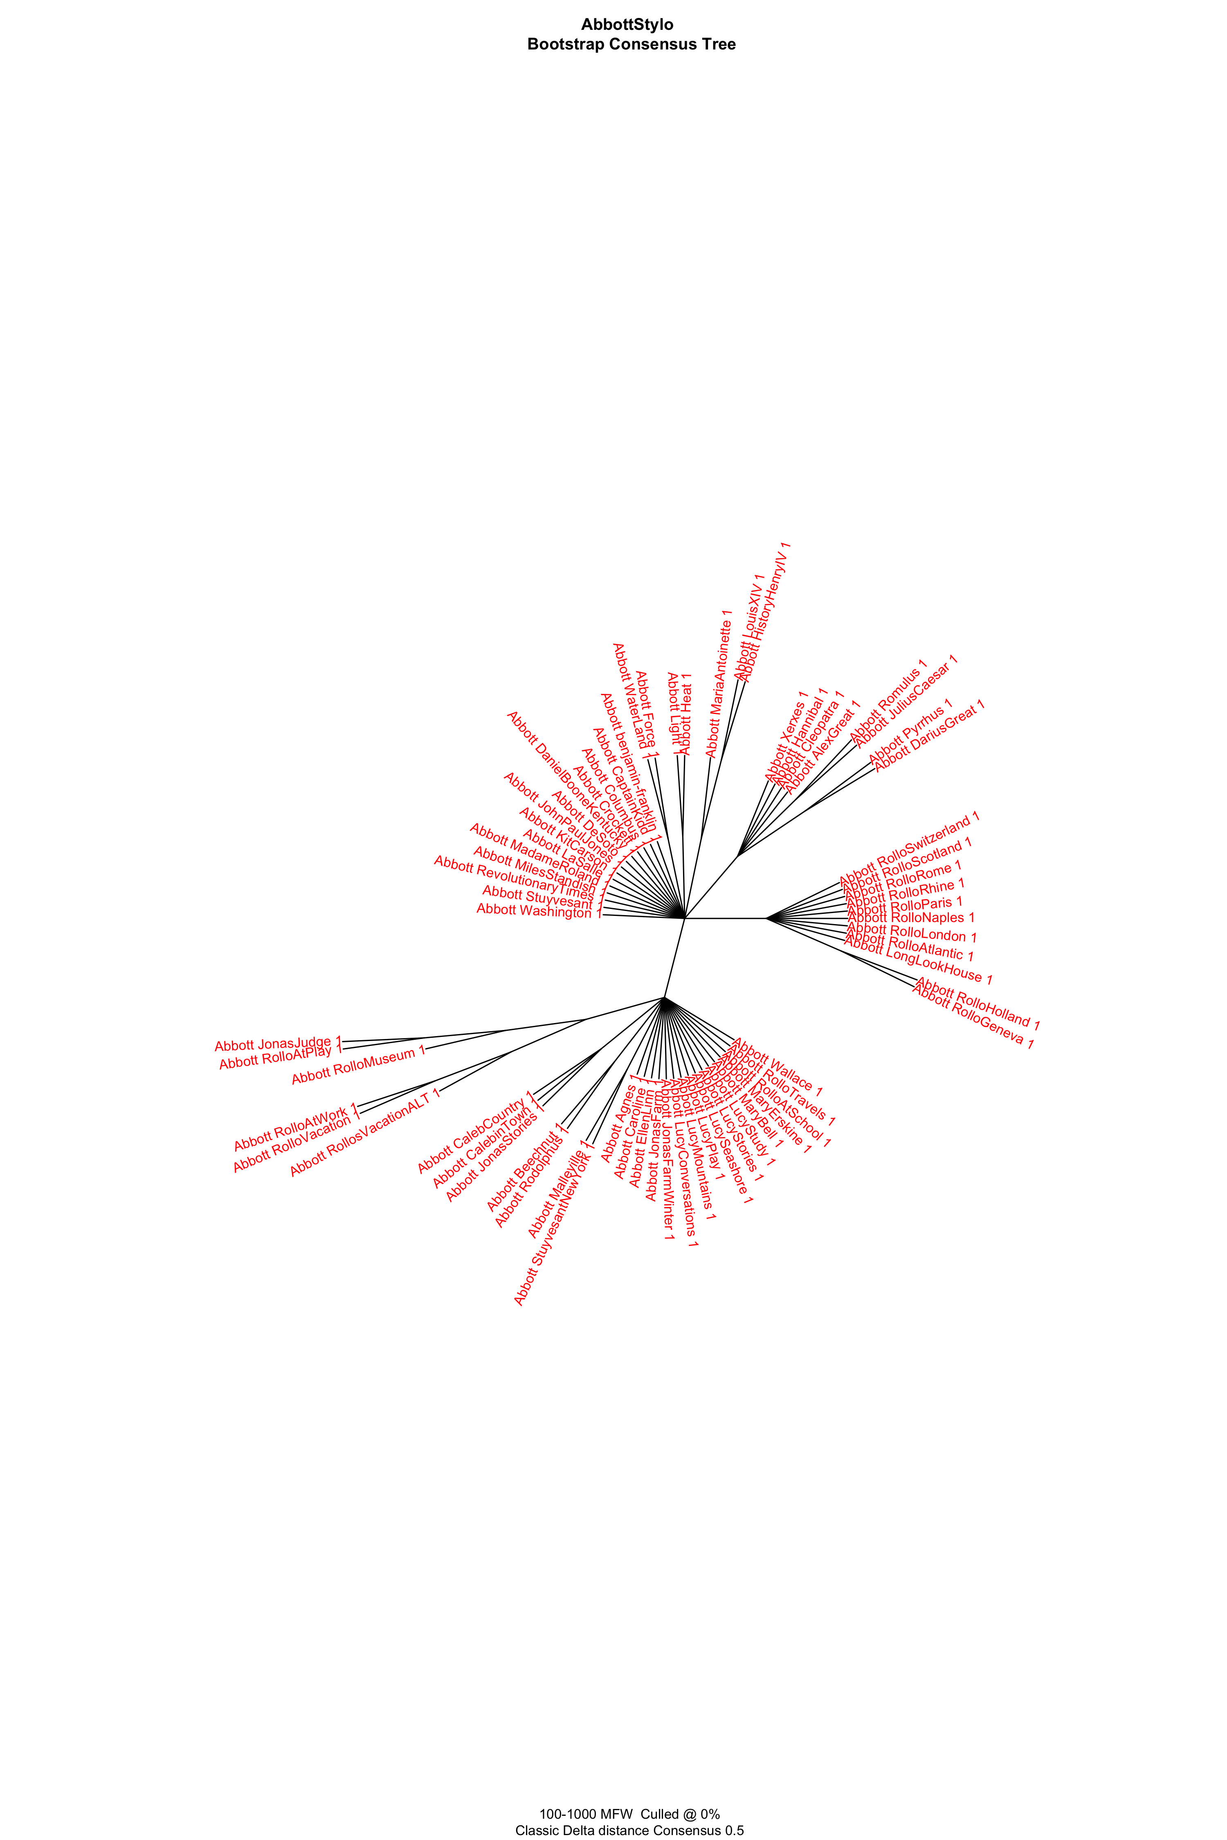
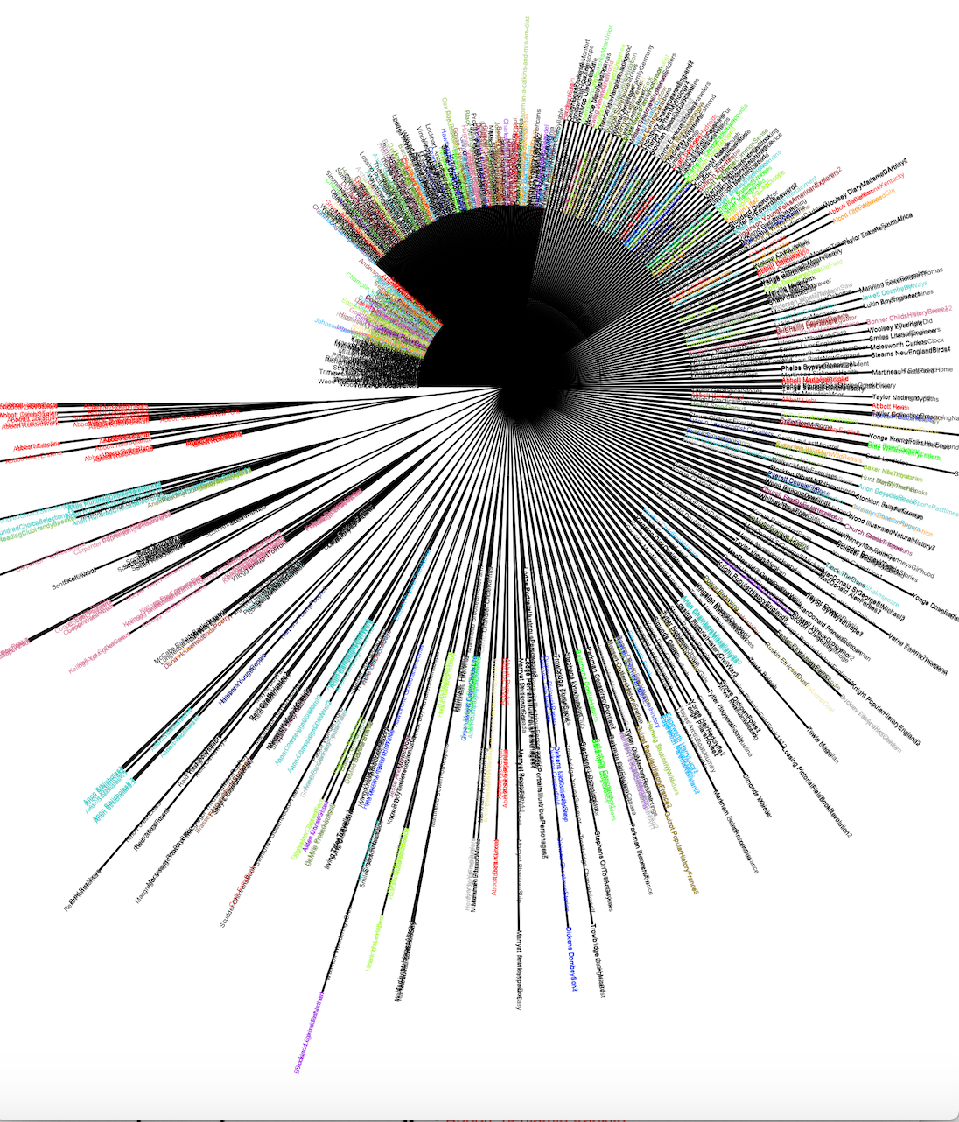

Slide 18
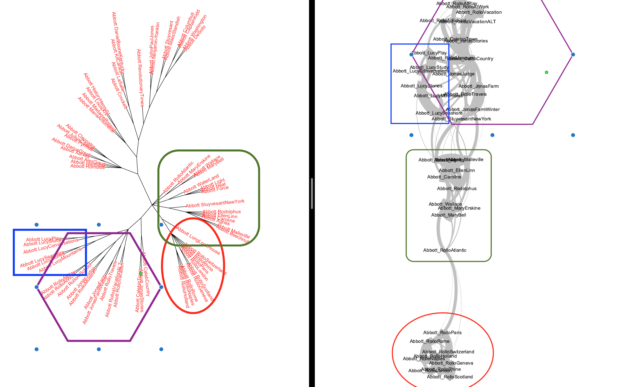

Slide 19
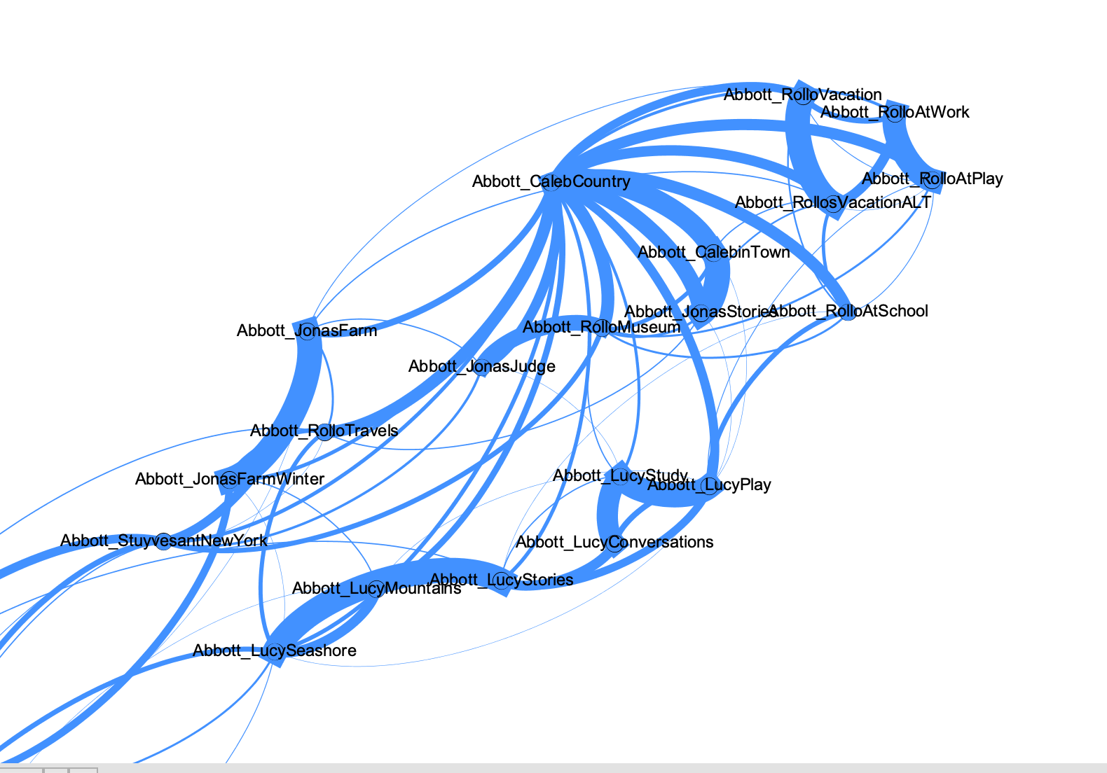
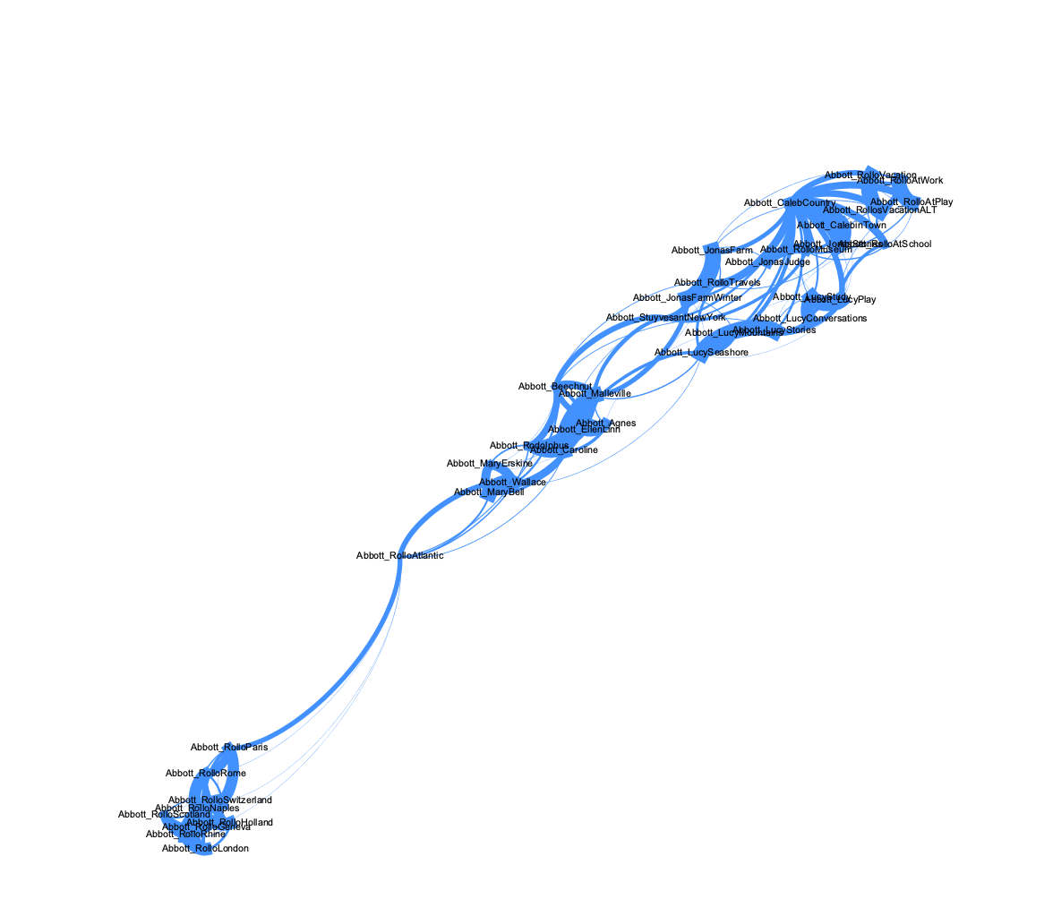
Network Analysis
19

Slide 20
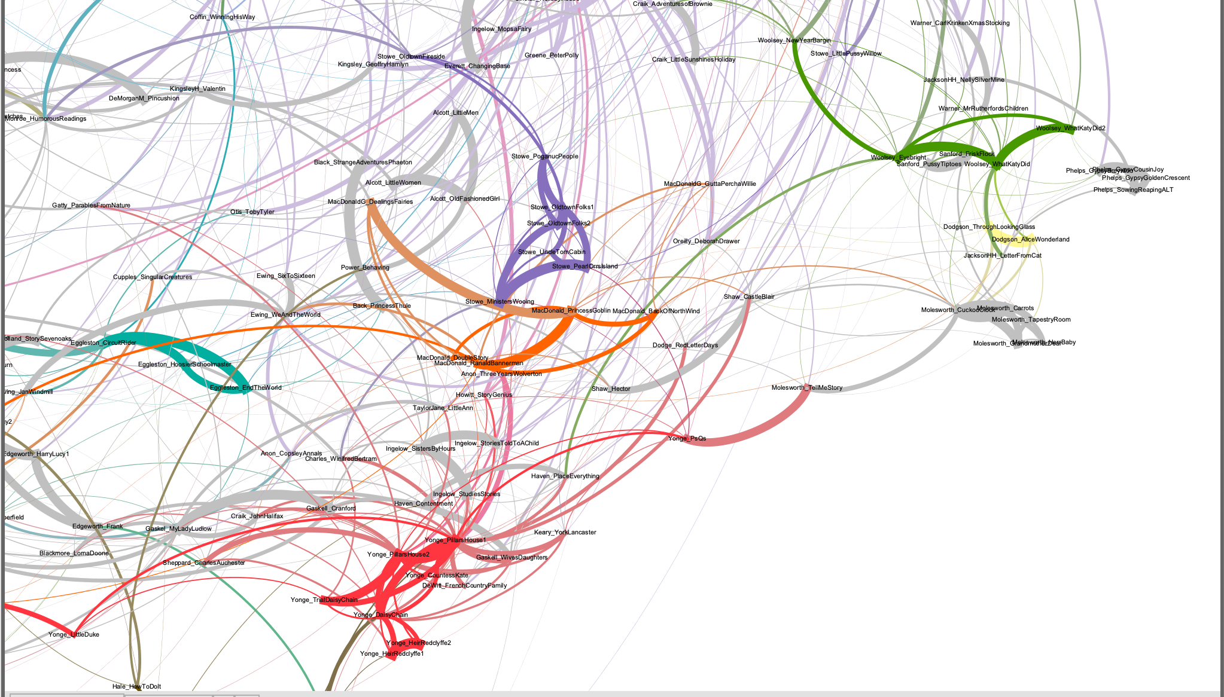

Slide 21
Through the study and processing of large amounts of literary data, the method calls our attention to general trends and missed patterns that we must explore in detail and account for with new theories
Jockers, M. Macroanalysis pg 29

Slide 22
3.
Analysis
Things that make you go “huh?”

Slide 23
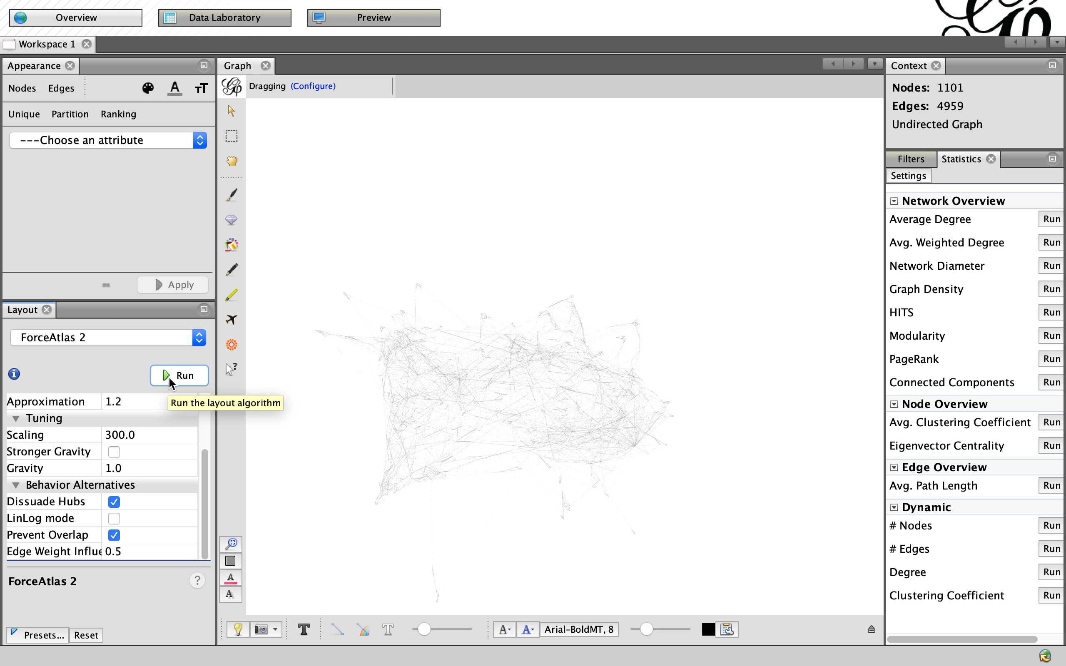
Animated Data Viz

Slide 24
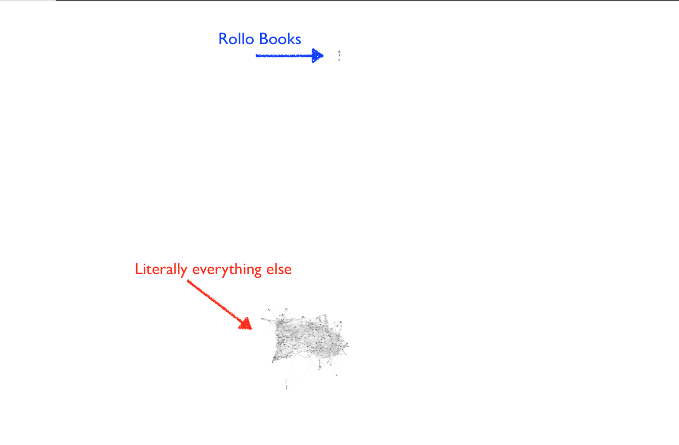
Abbott’s Rollo books
Not connected to the main cluster of texts AT ALL

Slide 25
Rollo = Outlier explanations
I messed something up.
  The data is corrupted somehow
    Examine the MFW list to detect patterns
    Show DH/IT folks the data
    Run tests on Abbott’s texts alone
One of these things is not like other
  Similar length to other texts
Something stylistically unique about Abbott’s texts that is worth paying attention to

Slide 26
4.
What comes next?
Where do we go from here?

Slide 27
Goals Moving Forward
Computer Skills
Regular expressions
New data viz platform
Learn to code?
Closer examination of data for errors
Statistics skills
Brush up on stats skills (or make friends with a statistics grad student who would like to co-author with me)
Examine Texts
Close reading of Rollo texts
Run MFW tests and look at data tables for texts in question to see what makes them stand out

Slide 28
PUBLISH!

Slide 29
THANKS!
Any questions?
You can find me at:
@DrFitzPhD
Rebekah.Fitzsimmons@lmc.gatech.edu

Slide 30
Citations
Eder, M., Rybicki, J. and Kestemont, M. (2016). Stylometry with R:
a package for computational text analysis. R Journal 8(1): 107-121 .https://journal.r-project.org/archive/2016/RJ-2016-007/index.html
Eder, M.. “Visualization in Stylometry: Cluster Analysis Using Networks.” Digital Scholarship in the Humanities, vol. 32, no. 1, Apr. 2017, pp. 50–64.
Jockers, M. L. Macroanalysis. Digital Methods and Literary History. University of Illinois Press, 2013
Pennebaker, James. 2011. The Secret Life of Pronouns: What Our Words Say About Us. New York, Bloomsbury Press.
Rybicki, J., Eder, M., Hoover, D. L. "Computational Stylistics and Text Analysis." in Doing Digital Humanities. Practice, Training, Research. Eds Crompton, C., Lane, R.J., Siemens, R. Oxford: Routledge, 2016, pp. 123-144.

Slide 31
CREDITS
Special thanks to all the people who made and released these awesome resources for free:
Presentation template by SlidesCarnival
Photographs by Unsplash

Slide 32
PRESENTATION DESIGN
This presentation uses the following typographies and colors:
Titles: Dosis
Body copy: Titillium Web
You can download the fonts on these pages:
http://www.impallari.com/dosis
http://www.campivisivi.net/titillium/
Pastel green #d3ebd5 · Green #80bfb7 · Teal #0b87a1 · Navy #01597f · Dark navy #003b55
You don’t need to keep this slide in your presentation. It’s only here to serve you as a design guide if you need to create new slides or download the fonts to edit the presentation in PowerPoint®

