Slide 1
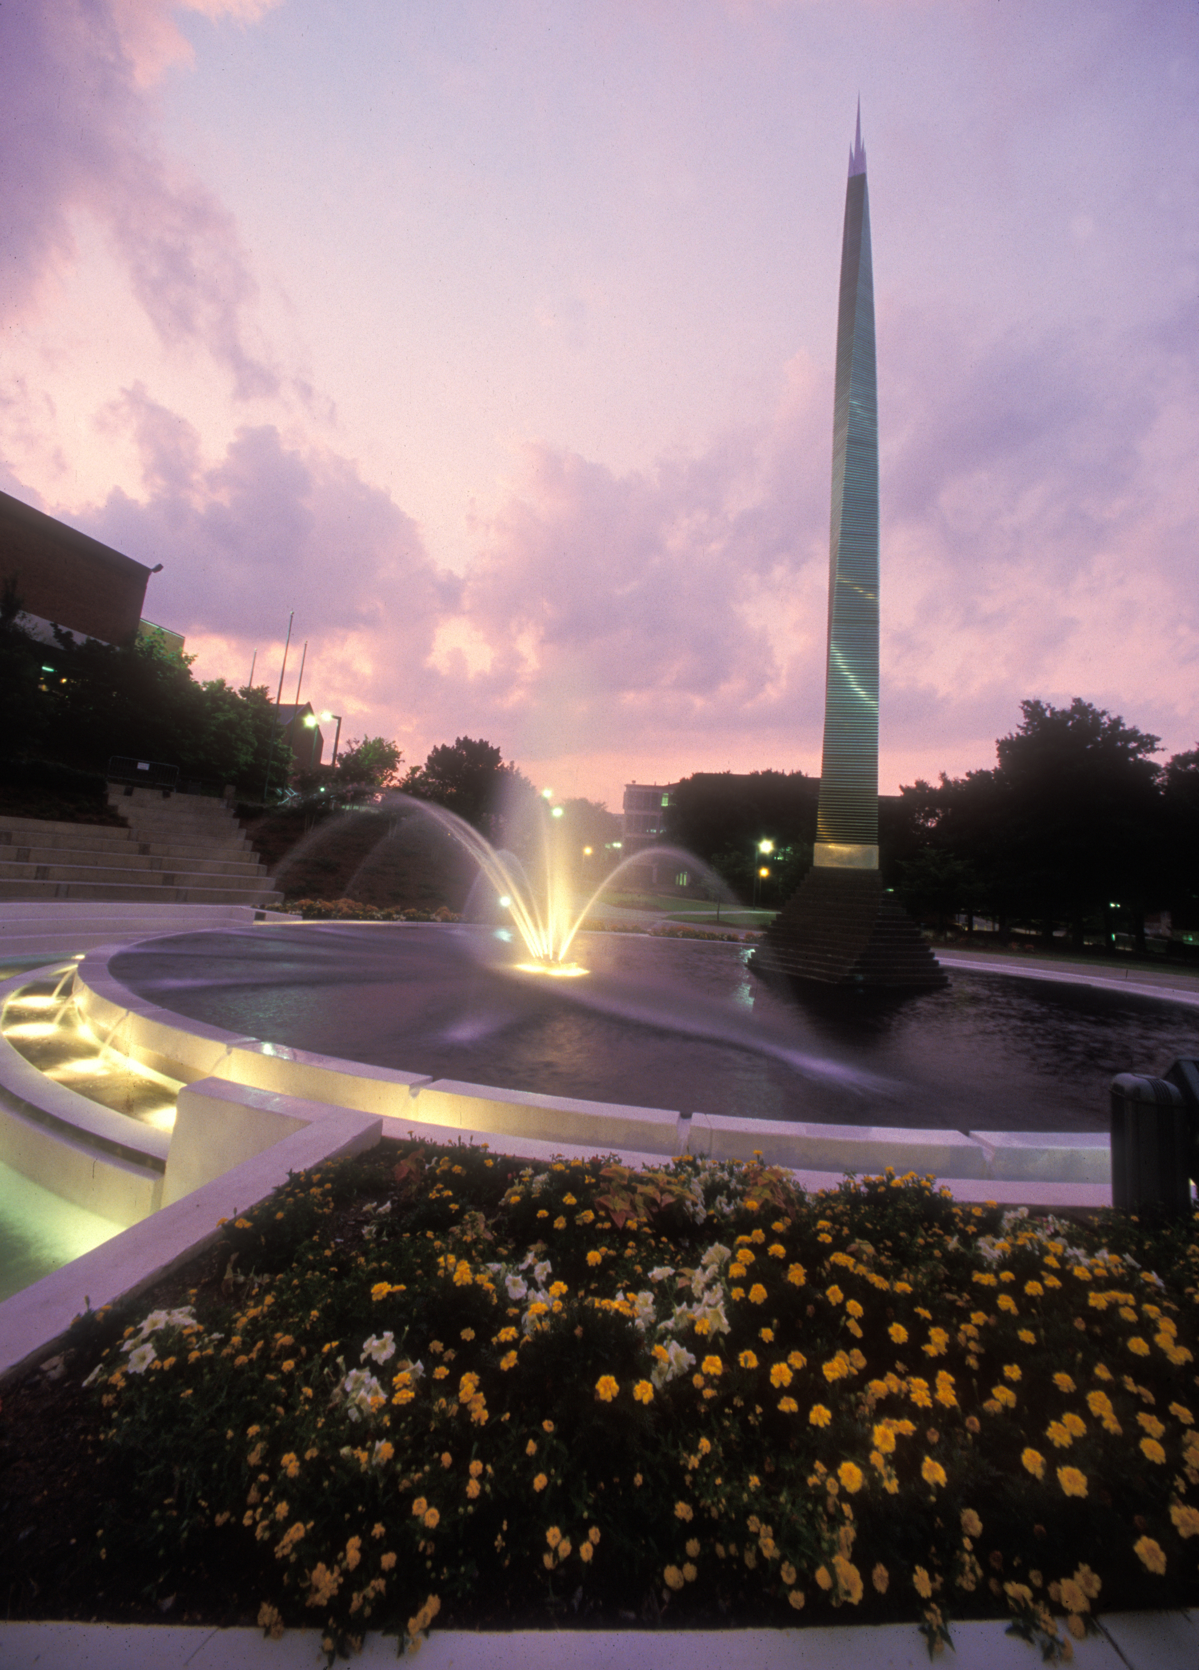
Digital Resources to Promote Access for Students with Disabilities
Dr. Rebekah Fitzsimmons
RebekahFitzsimmons.com
@DrFitzPhD
Georgia Institute of Technology

Slide 2
Philosophy

Slide 3
Digital Pedagogy
Digital Pedagogy
Digital Technology in Teaching
Use digital tools to teach
Use digital tools to collect/assess student work
Digital technologies in Assignments
Podcasts, video essays, blog posts, Twitter
Digital mindset in designing, teaching
Play
Try, experiment, fail, try again
Multimodal

Slide 4
Accessible Pedagogy
Accessibility
Never Stop Learning
Professional development opportunities
Attend panels like this ione
Resources in the public realm
Genuine Care Ethic for Students
Build accessible options into your syllabi
Build good habits towards making your content accessible

Slide 5
START NOW
Presenting tomorrow?
Teaching Monday?
It’s not too late!

Slide 6
Presenting Next Session?
First Steps
Use the microphone, repeat questions
Face the audience when speaking
Post your slides and paper/script
  Mention where during your talk
  Include a short link on your first slide
More Advanced Steps
Bring copies of slides/text of talk to your presentation

Slide 7
Priorities

Slide 8
Designing Materials: Priority List
1. Video Captions/Transcripts
Use existing captions, create captions for videos you make, provide transcripts for podcasts
2. Meaningful Links
Create hyperlinks out of text that describes the site, rather than long strings of nonsensical text
3. Headings & Document Structure
Use headings and built in features to structure a document easily read by screen readers
4. Color & Contrast
Use high contrast colors when designing documents, presentation slides, visuals
5. Image Alt-Text
Provide descriptive alternative text for images in your presentations and written materials.
6. Listen and Respond
If someone tells you something you’ve done isn’t working, listen, change what you can, and learn for the future

Slide 9
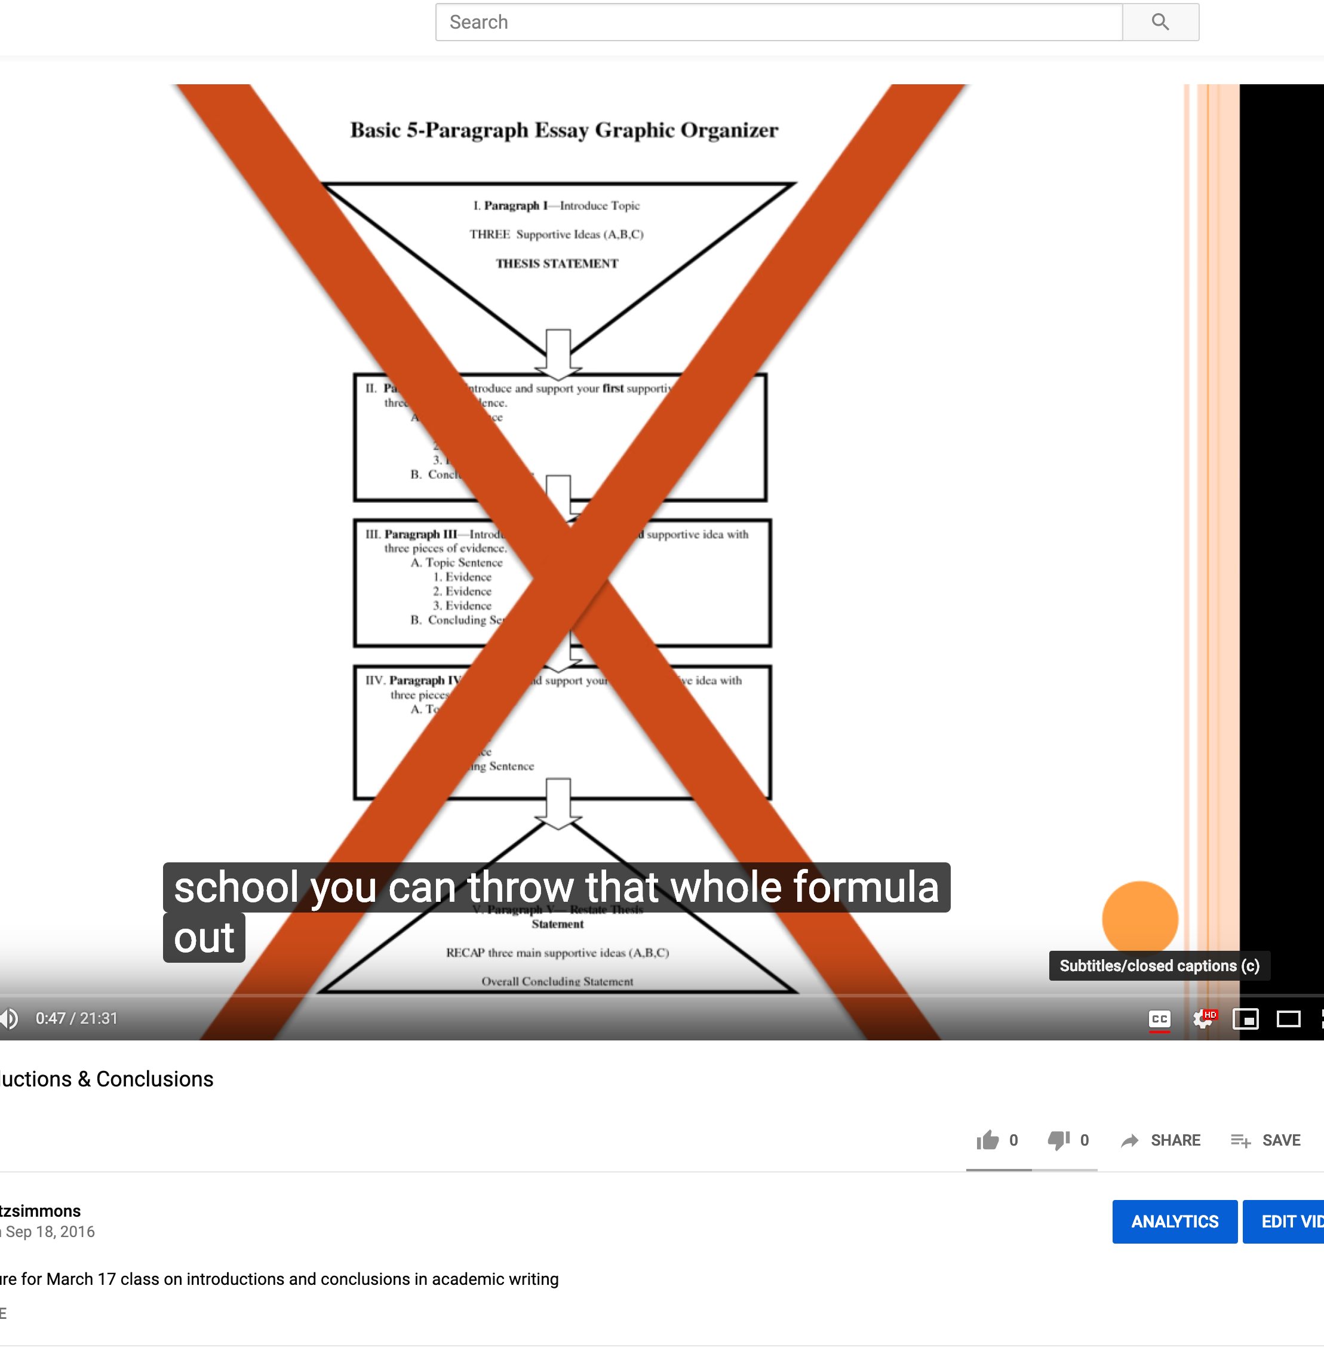
Use Captions When Screening Videos
First Steps
Turn on Closed Captions for DVDs, Netflix, Hulu,
Select option to create captions on YouTube videos you upload
More Advanced Steps
Use tool like Amara to create captions for video that doesn’t have them already
  https://amara.org/en/

Slide 10
Create Meaningful Hyperlinks
Bad Hyperlinks
http://www.caseyalanewilson.com/blog/2017/8/20/simple-steps-to-a-more-inclusive-classroom
Meaningful Hyperlink
Casey Wilson’s Blog Entry on Inclusive Classrooms

Slide 11
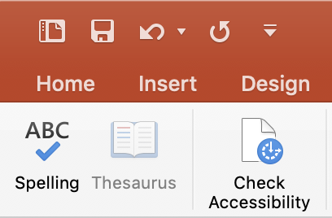
Use Accessibility Checkers
First Steps
Locate any built-in accessibility checkers
Run an accessibility check
Implement what you can
Priority List Items It Will Check
Headings and Document Structure
Alternate Text for Images

Slide 12
Use Accessibility Checkers
More Advanced Steps
Use built-in features to improve accessibility
  Title/Body Text Boxes in PPT templates
Read up on universal design for accessibility
  Design visuals with these standards in mind
Develop habits that support accessibility
  Alt text for images
  Meaningful links

Slide 13
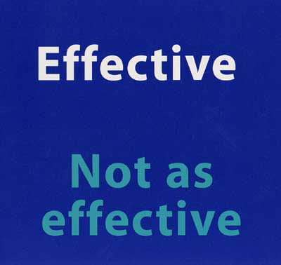
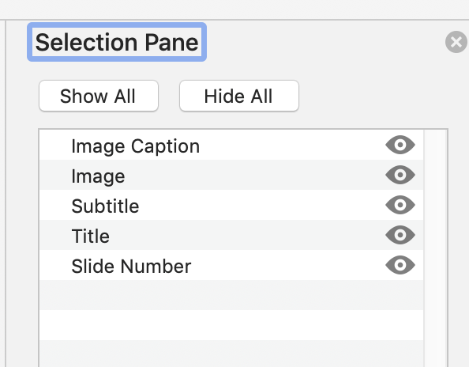
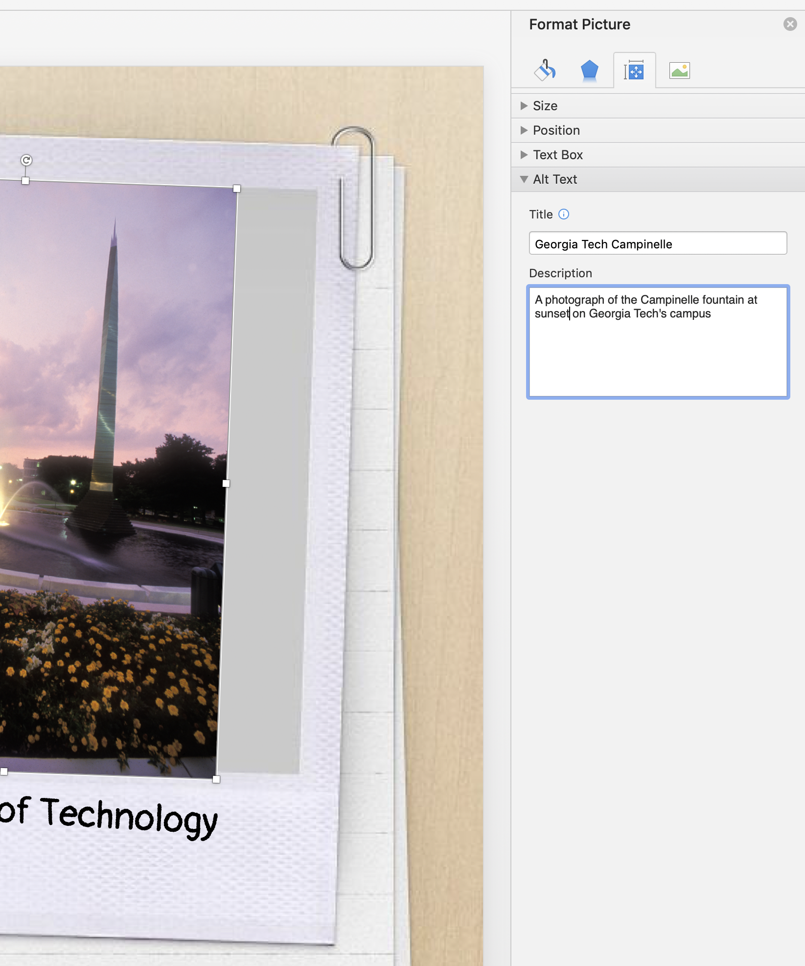
Tips to Make Your PPT More Accessible
High Contrast Text
Use sans serif fonts
Use high contrast colors
  Black & White
  Complementary colors
Not sure what works? Stick to templates
Document Structure
Home menu
Arrange Icon
Selection Pane option
Order items to be read bottom to top
Alternate Text
Format Picture
Size & Properties option
Alt Text
Add title and description of image for visually impaired audience members

Slide 14
Plan Ahead
Syllabus Policies
and
Assignment Design

Slide 15
How can I make sure all of my students are able to participate and access as much of my class content as possible?

Slide 16
Syllabus Policies
Banning laptops and phones can be a ban on assistive technologies
ADA language – students can tell when a policy is required versus genuinely meant
Policies can be firm/rigorous but also empathetic/ human

Slide 17
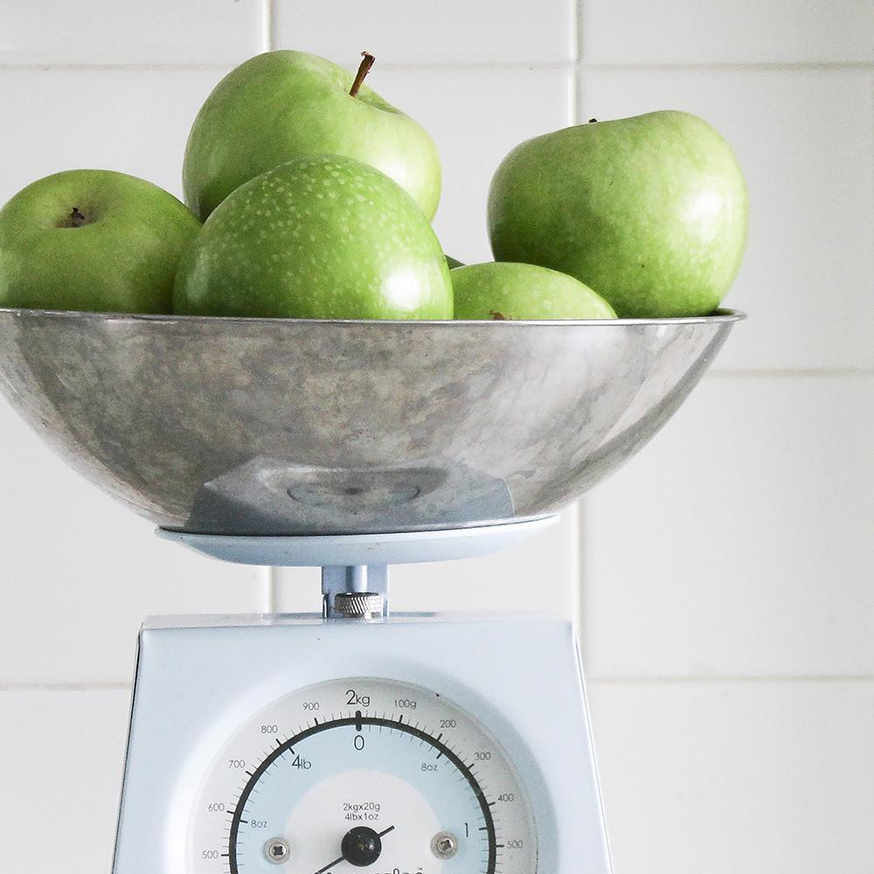
Policies I Add to My Syllabi
No Questions Asked Extension Policy
1 per semester
Individual projects only
24 hours before the due date
Set the new deadline
Late policy applies from the new deadline
Revision Policy
1 per semester
80% or below on assignment
Request includes plan for revision based on my feedback
Student sets deadline within 2 week window

Slide 18
Syllabus Design
Visual Design
  Easy to read
  Font sizes
Accessible design
  Headings
  Document structure

Slide 19
Assignments

Slide 20
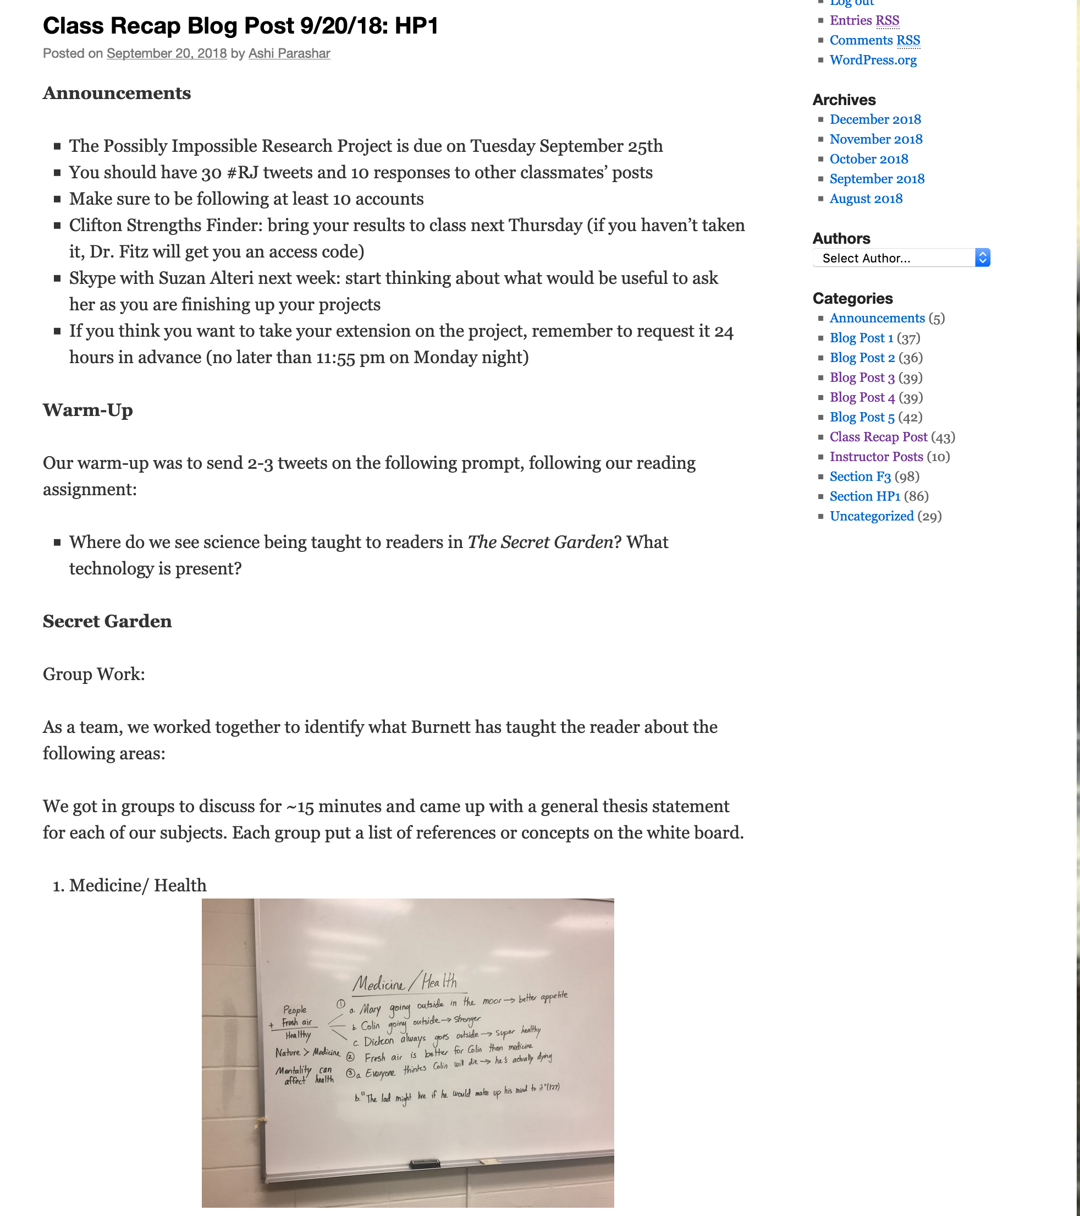
Recap Blogs
Each student assigned a class period
Take “minutes” for the day
  Announcements
  Lecture Notes
  Discussion
  Activities
  Homework
Multimodal
  Photos of the board
  Links to materials
  Accessible design

Slide 21

Model Accessibility In Assignment Design
Podcast Assignment = Include Transcript
Video Assignment = Include Captions
Presentation with visuals = Include Alt-Text and Reading Order as required elements
Technical Communication Documents (reports, memos, instructions) = Include headers and structural elements for assistive technologies
Research Papers = Alt-Text and Headers/Document Structure

Slide 22
Adapt,
Listen,
Learn

Slide 23
Learn More
Twitter Hashtags
#a11y
#DigPed
#EdTech
#Pedagogy
Digital Humanities Summer Institute
Institutions Disability Services Office or Center for Teaching and Learning

Slide 24

Resources
Make Visual Presentations Accessible: World Blind Union
Steps to a More Inclusive Classroom: Casey Wilson
Alt Text Guidance – Accessibility U
Digital Learning and Accessibility Tool Parade: DHSI 17
Amara – Make Captions
Hybrid Pedagogy

Slide 25
Thanks!
Any questions?
You can find me at:
@DrFitzPhD
RebekahFitzsimons.com
  Slides, materials, handouts here -> Current Research tab

Slide 26
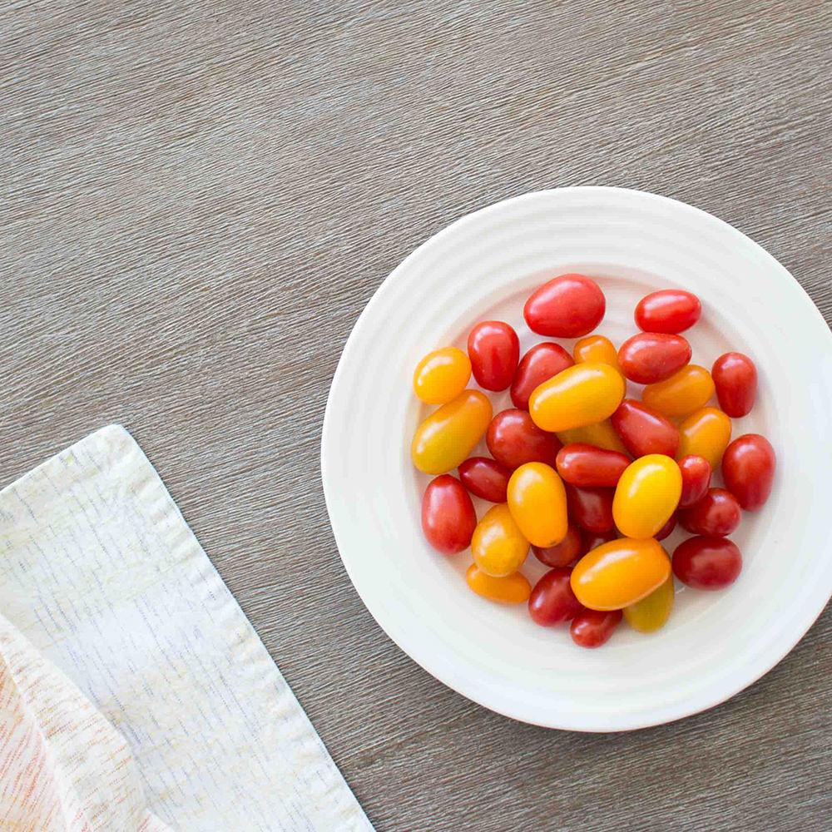
Credits
Special thanks to all the people who made and released these awesome resources for free:
Presentation template by SlidesCarnival
Photographs by Death to the Stock Photo (license)

Slide 27
SlidesCarnival icons are editable shapes.
This means that you can:
Resize them without losing quality.
Change fill color and opacity.
Isn’t that nice? :)
Examples:

