Slide 1
The Handbook for Mortals and the Muddy Waters of YA Best Seller Status
Dr. Rebekah Fitzsimmons
Georgia Institute of Technology
@DrFitzPhD
Rebekah.Fitzsimmons@lmc.gatech.edu
Slide deck and text version @ rebekahfitzsimmons.wordpress.com

Slide 2
Shenanigans
For a more complete version see: “Did This Book Buy Its Way Onto the Best Seller List?” by Kaylee Donaldson @ Pajiba.com

Slide 3
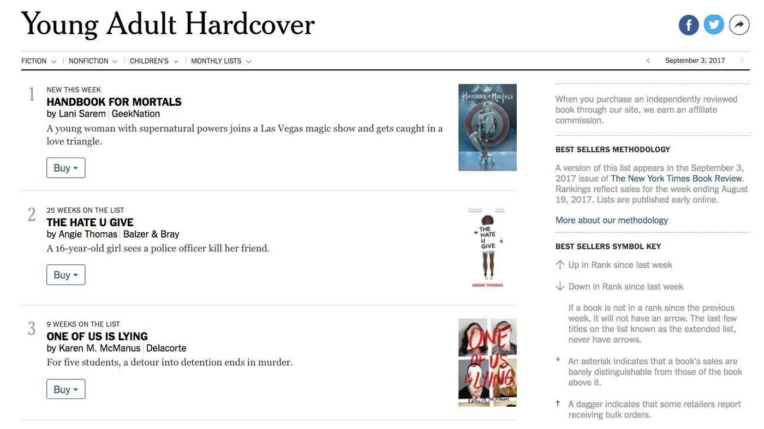
8:00am, Aug. 24, 2017: Advanced Copy

Slide 4
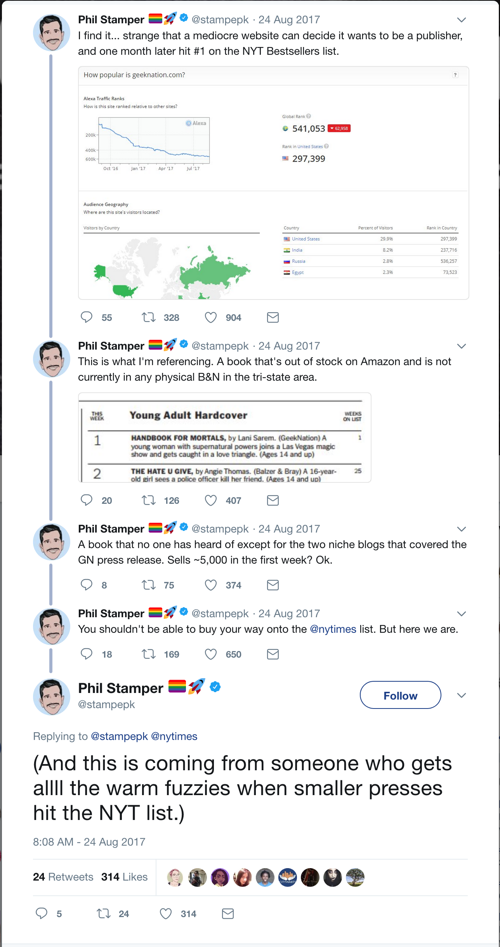
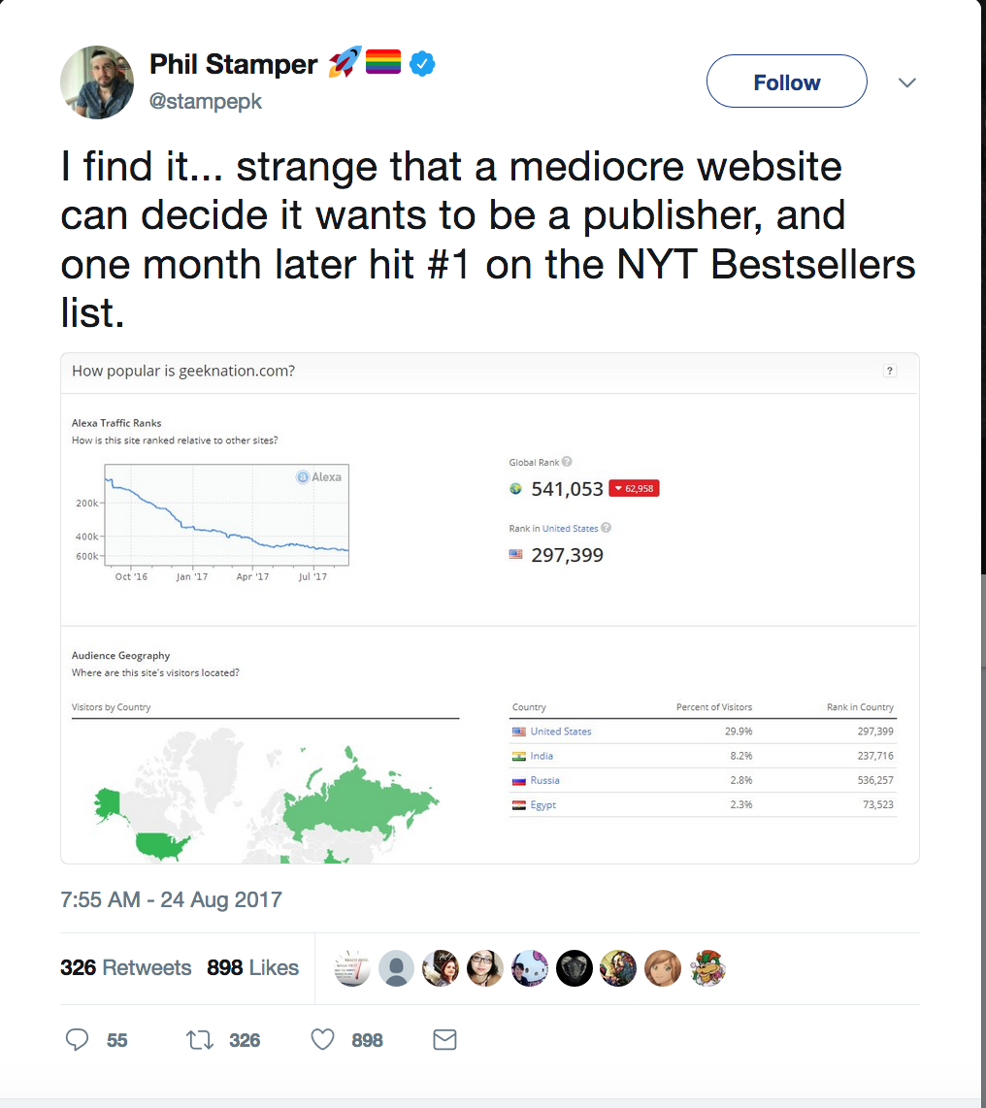
It Begins . . .

Slide 5
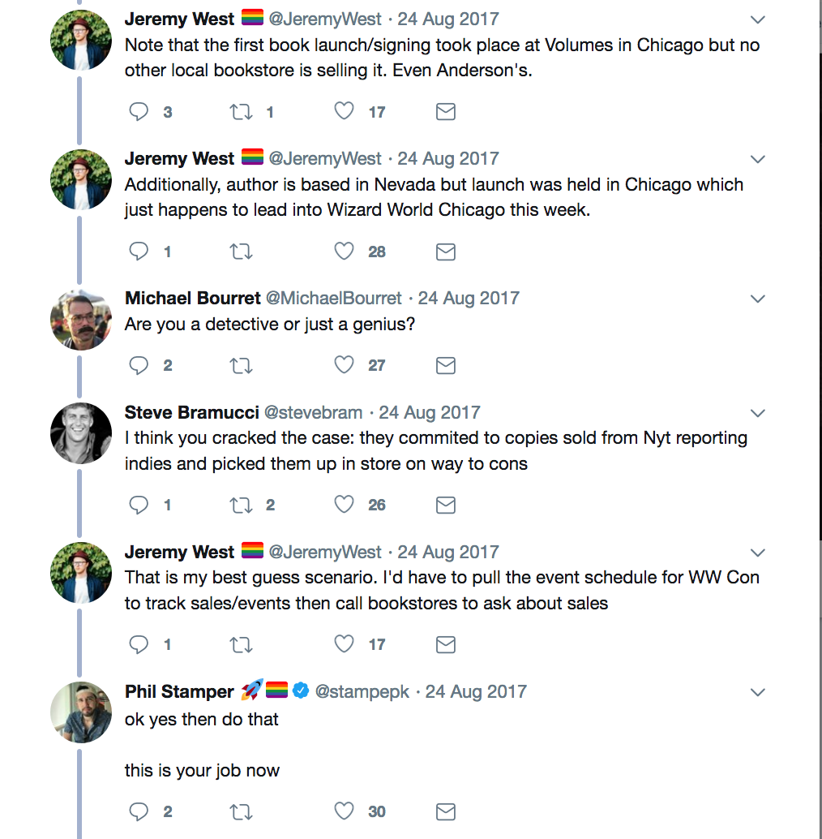
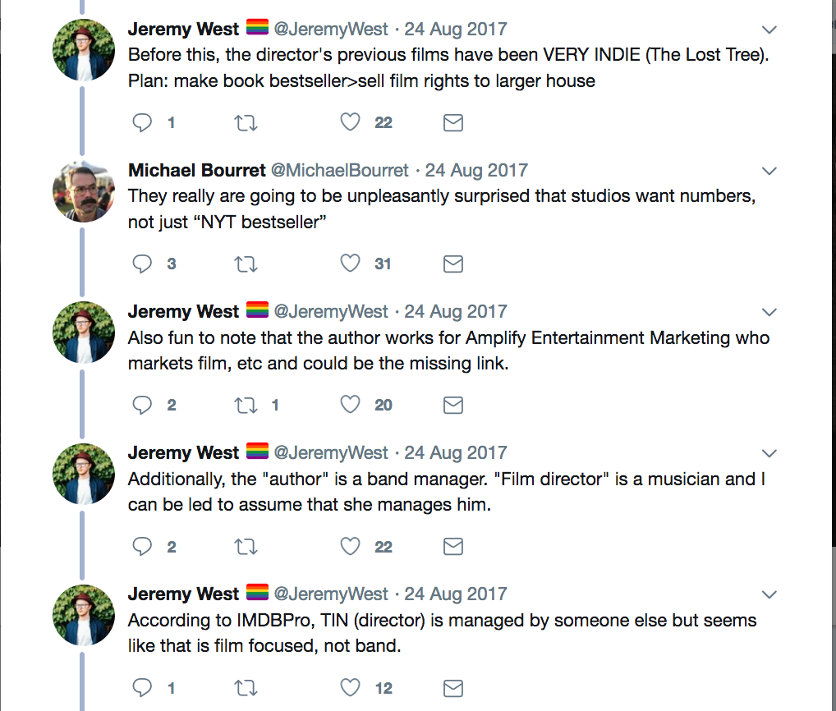
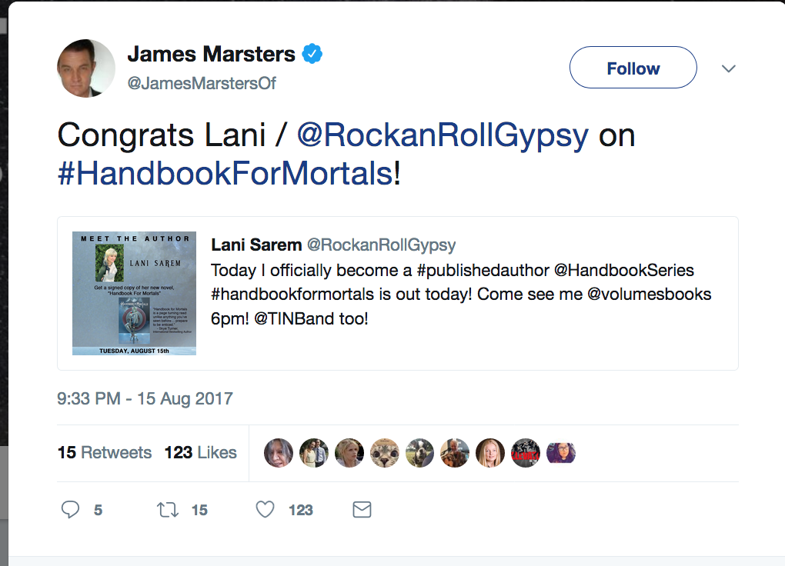
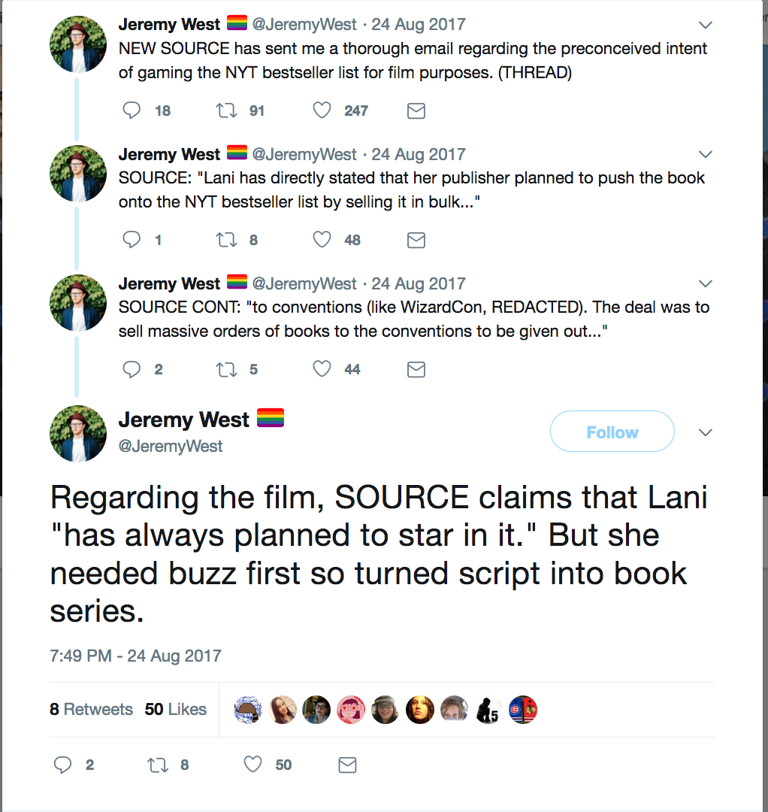
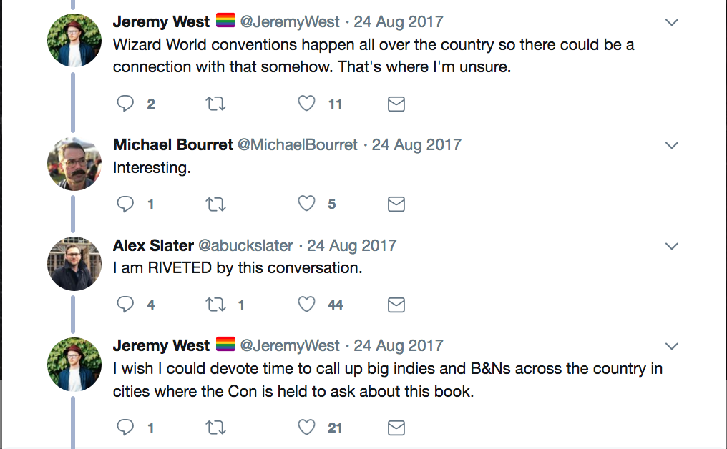
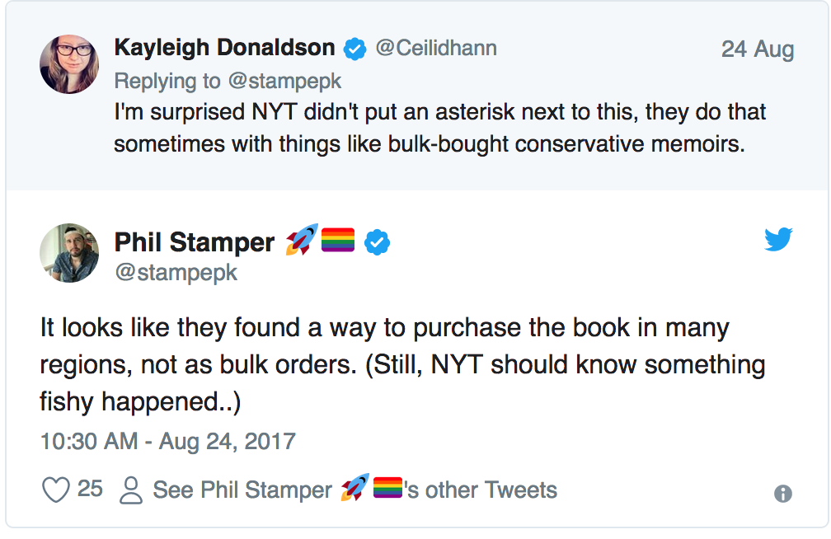
YA Twitter Investigates
Spike from Buffy

Slide 6
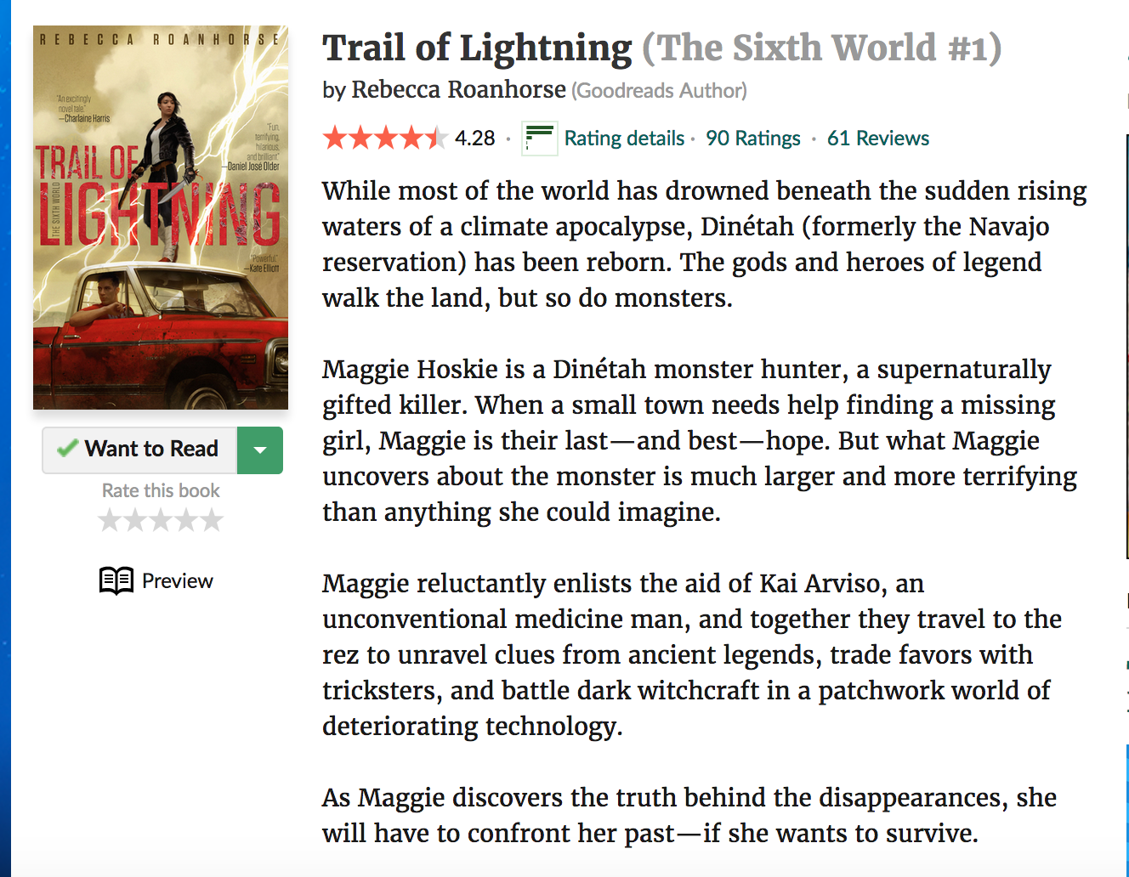
Red Flags
Publisher, GeekNation, announced Handbook for Mortals 1 month prior
Debut author, Lani Sarem, unknown in YA community
Virtually no publicity campaign, touring, word-of-mouth coverage
  9 Goodreads reviews, all 5 stars, duplicates
  11 Amazon reviews, deemed unreliable by Fakespot.com
No ARCs made available to children’s lit/YA community
Out of stock on Amazon, B&N.com and local branches of large bookstores
Sold 18,000 copies in its first week (most YA bestsellers average 5,000)
6/26/18 @ 11:00am

Slide 7
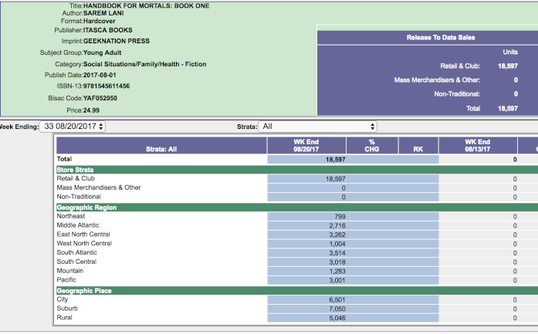
By the numbers

Slide 8
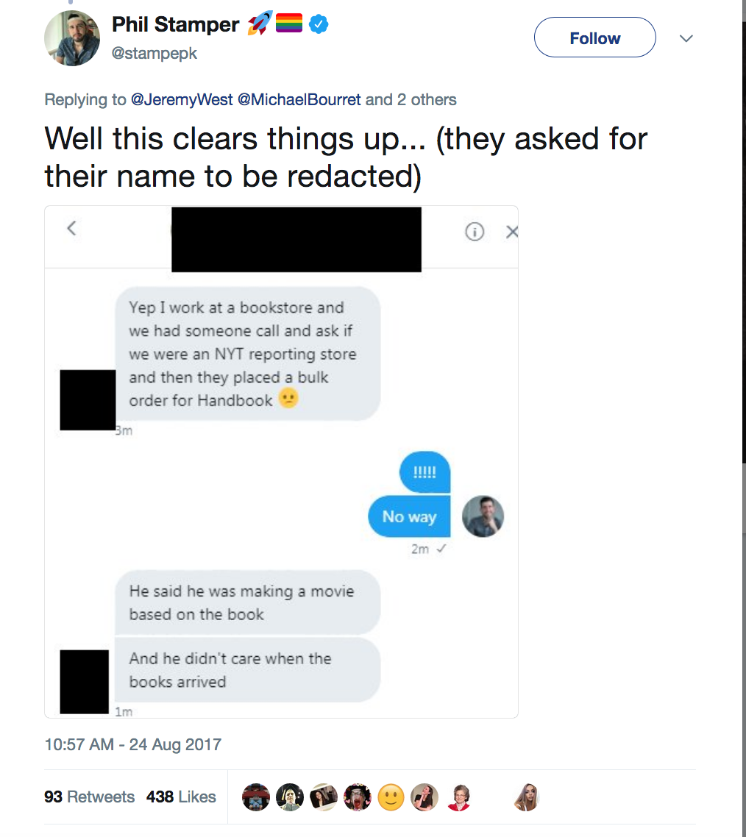
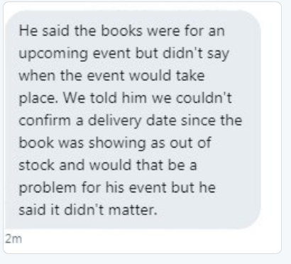
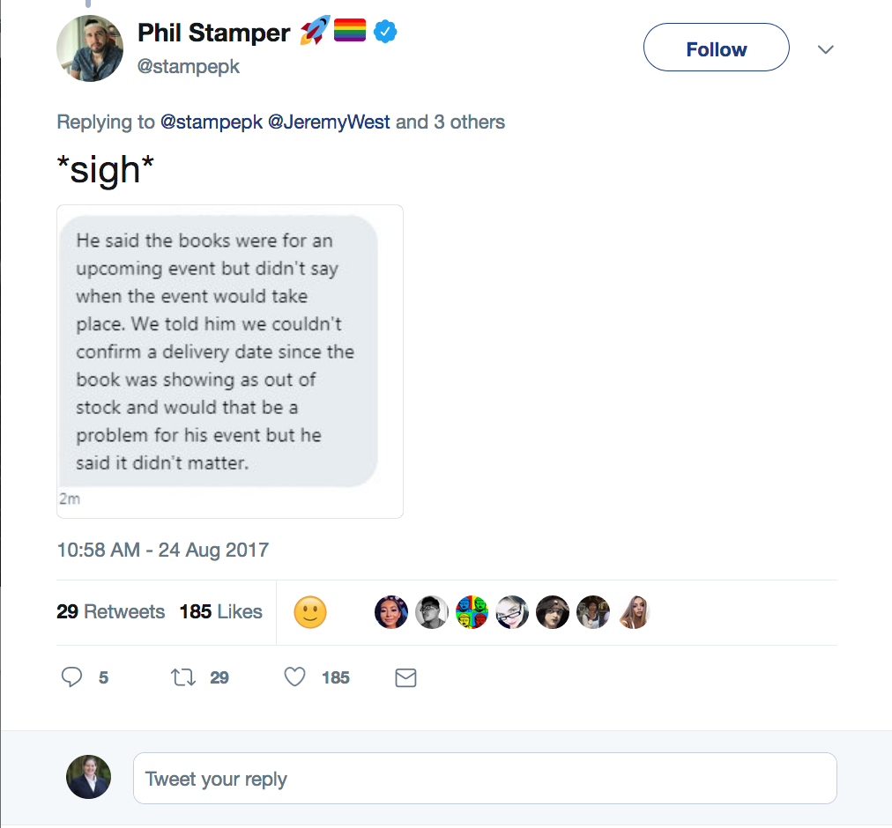
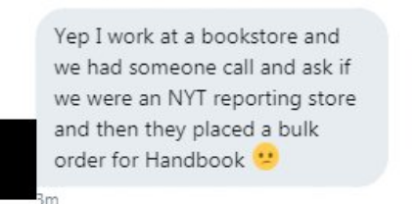
The Plot Thickens

Slide 9
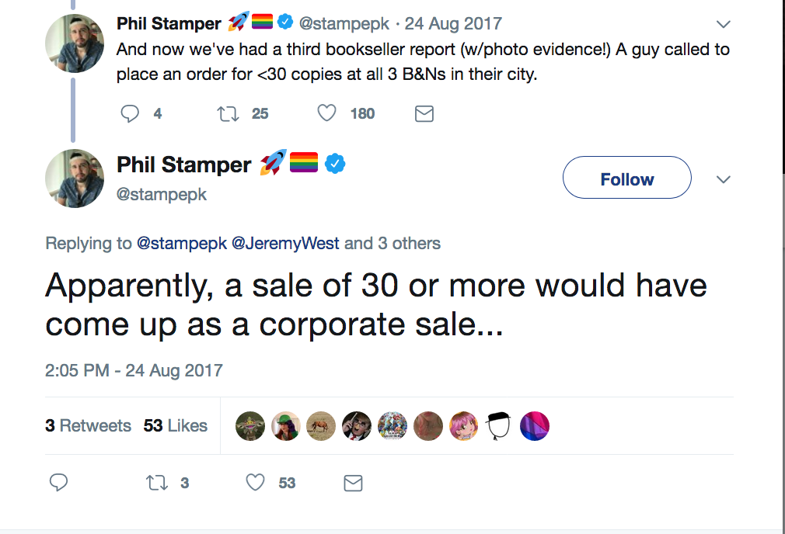
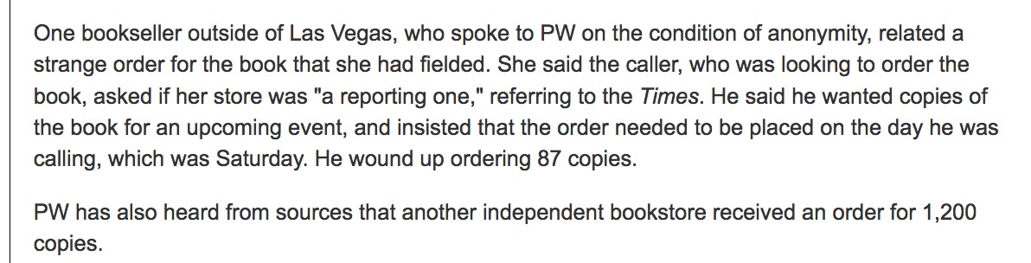

Slide 10
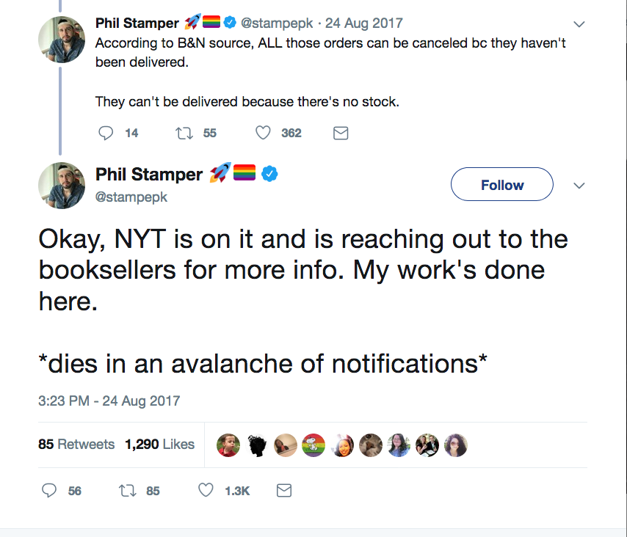
NYTimes Takes Notice
In a statement, a New York Times spokesperson told [Publishers Weekly]:
"After investigating the inconsistencies in the most recent reporting cycle, we've decided that the sales for Handbook for Mortals do not meet our criteria for inclusion. We'll be issuing an updated Young Adult Hardcover list for September 3 which will not include that title."

Slide 11
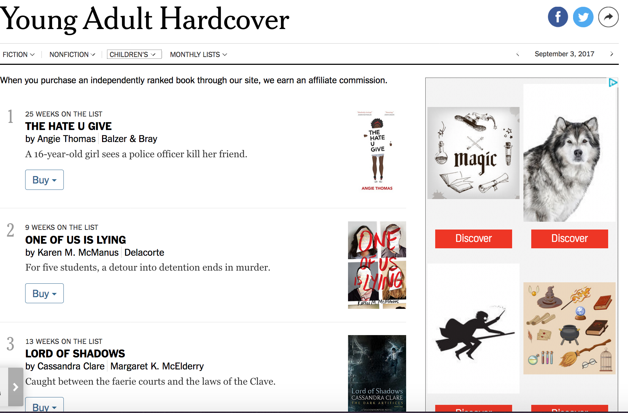
6:00pm, Aug. 24, 2017: Revised List

Slide 12
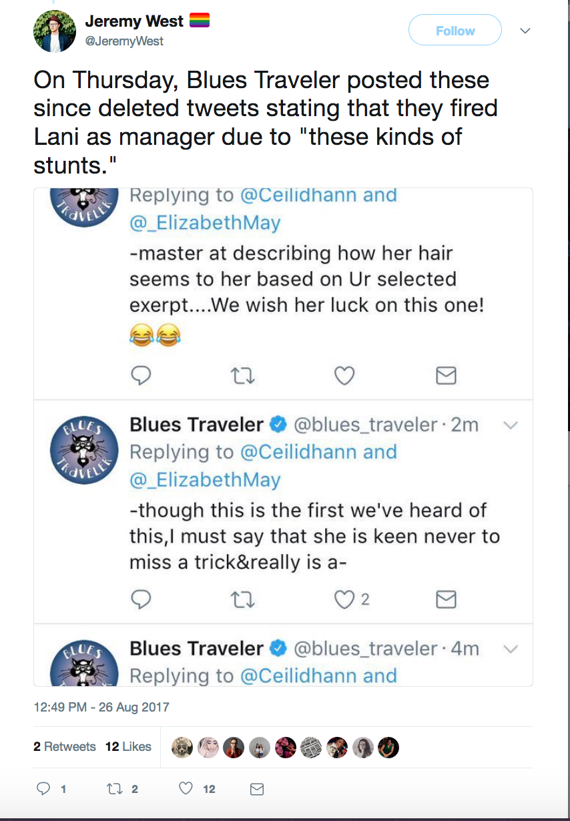
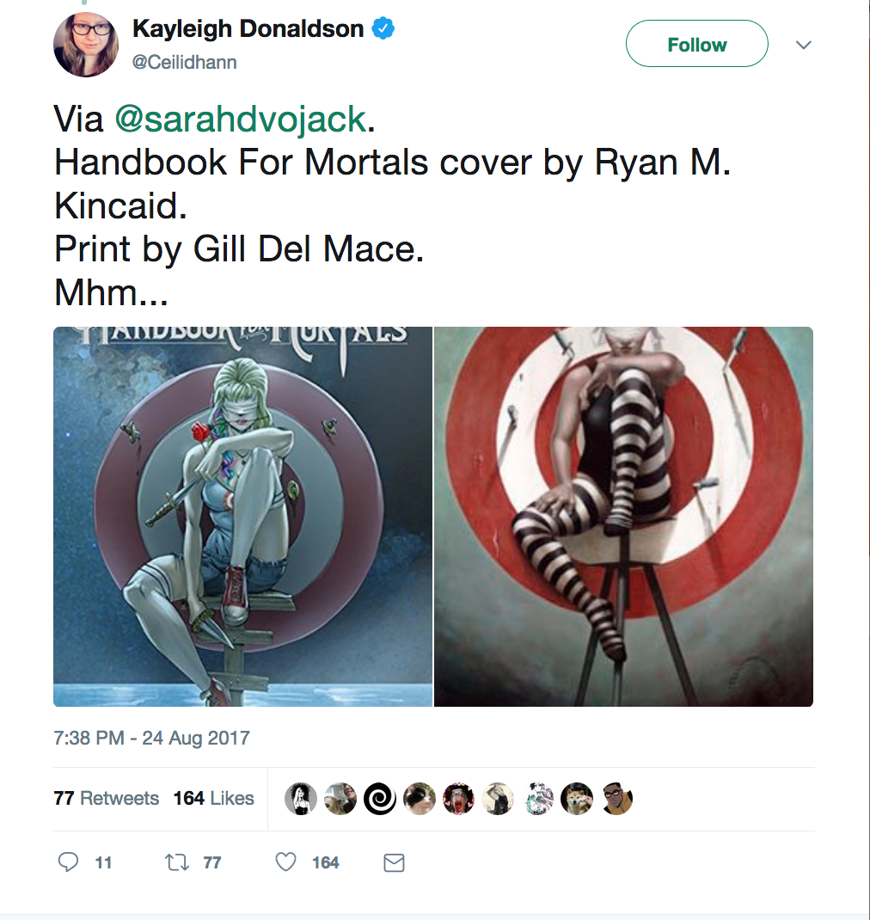
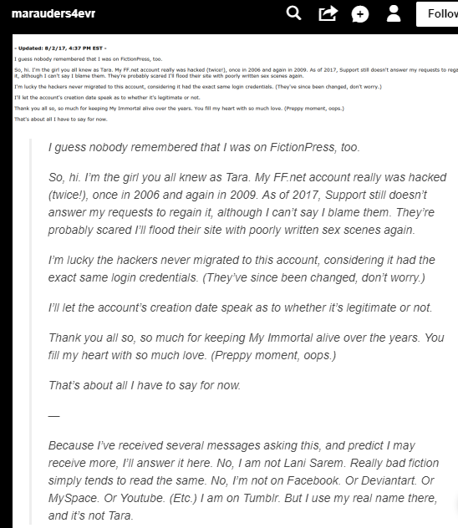
But wait, there’s more!
My Immortal fanfic denial
Blues Traveler weighs in
Plagiarized Cover Art

Slide 13
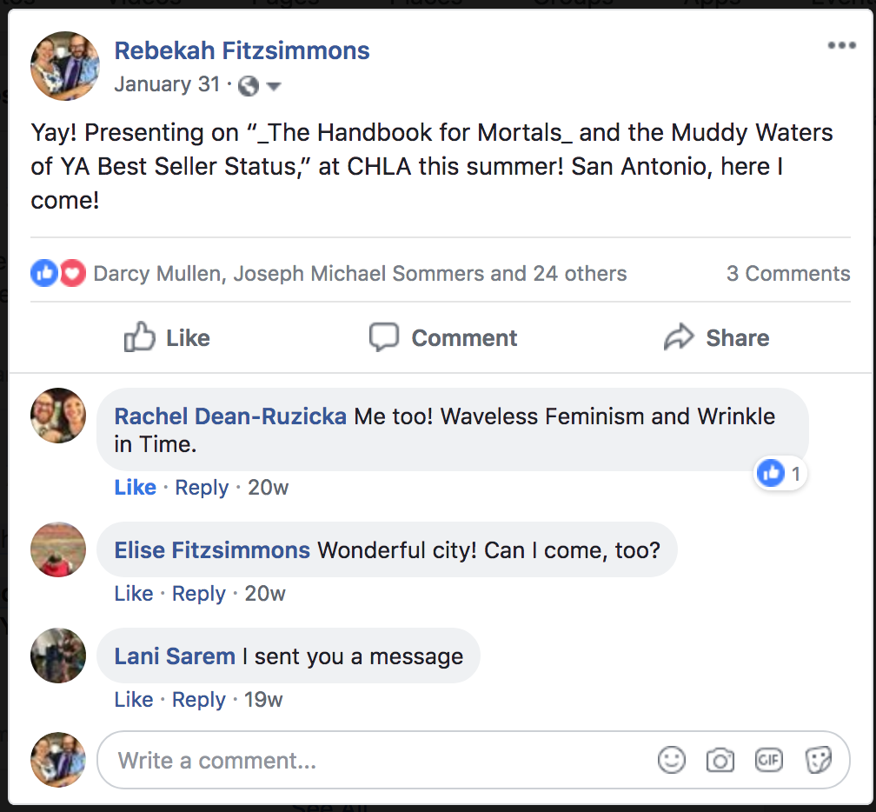
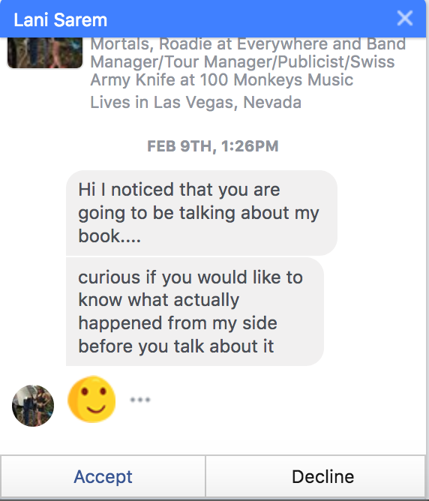
Full disclosure

Slide 14
High Stakes of Bestseller Status

Slide 15
YA Twitter
To Tweet or not to Tweet . . . .

Slide 16
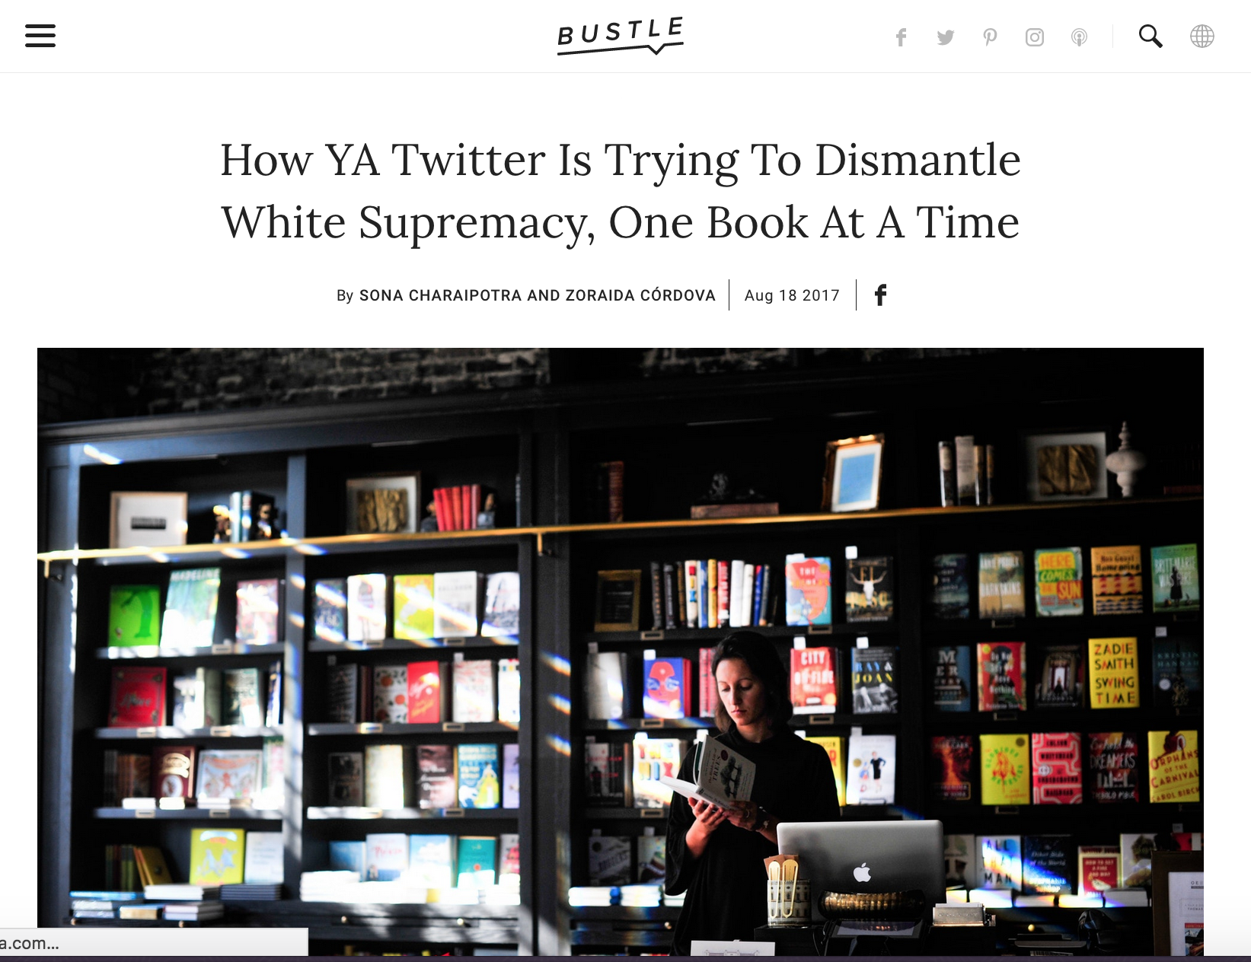
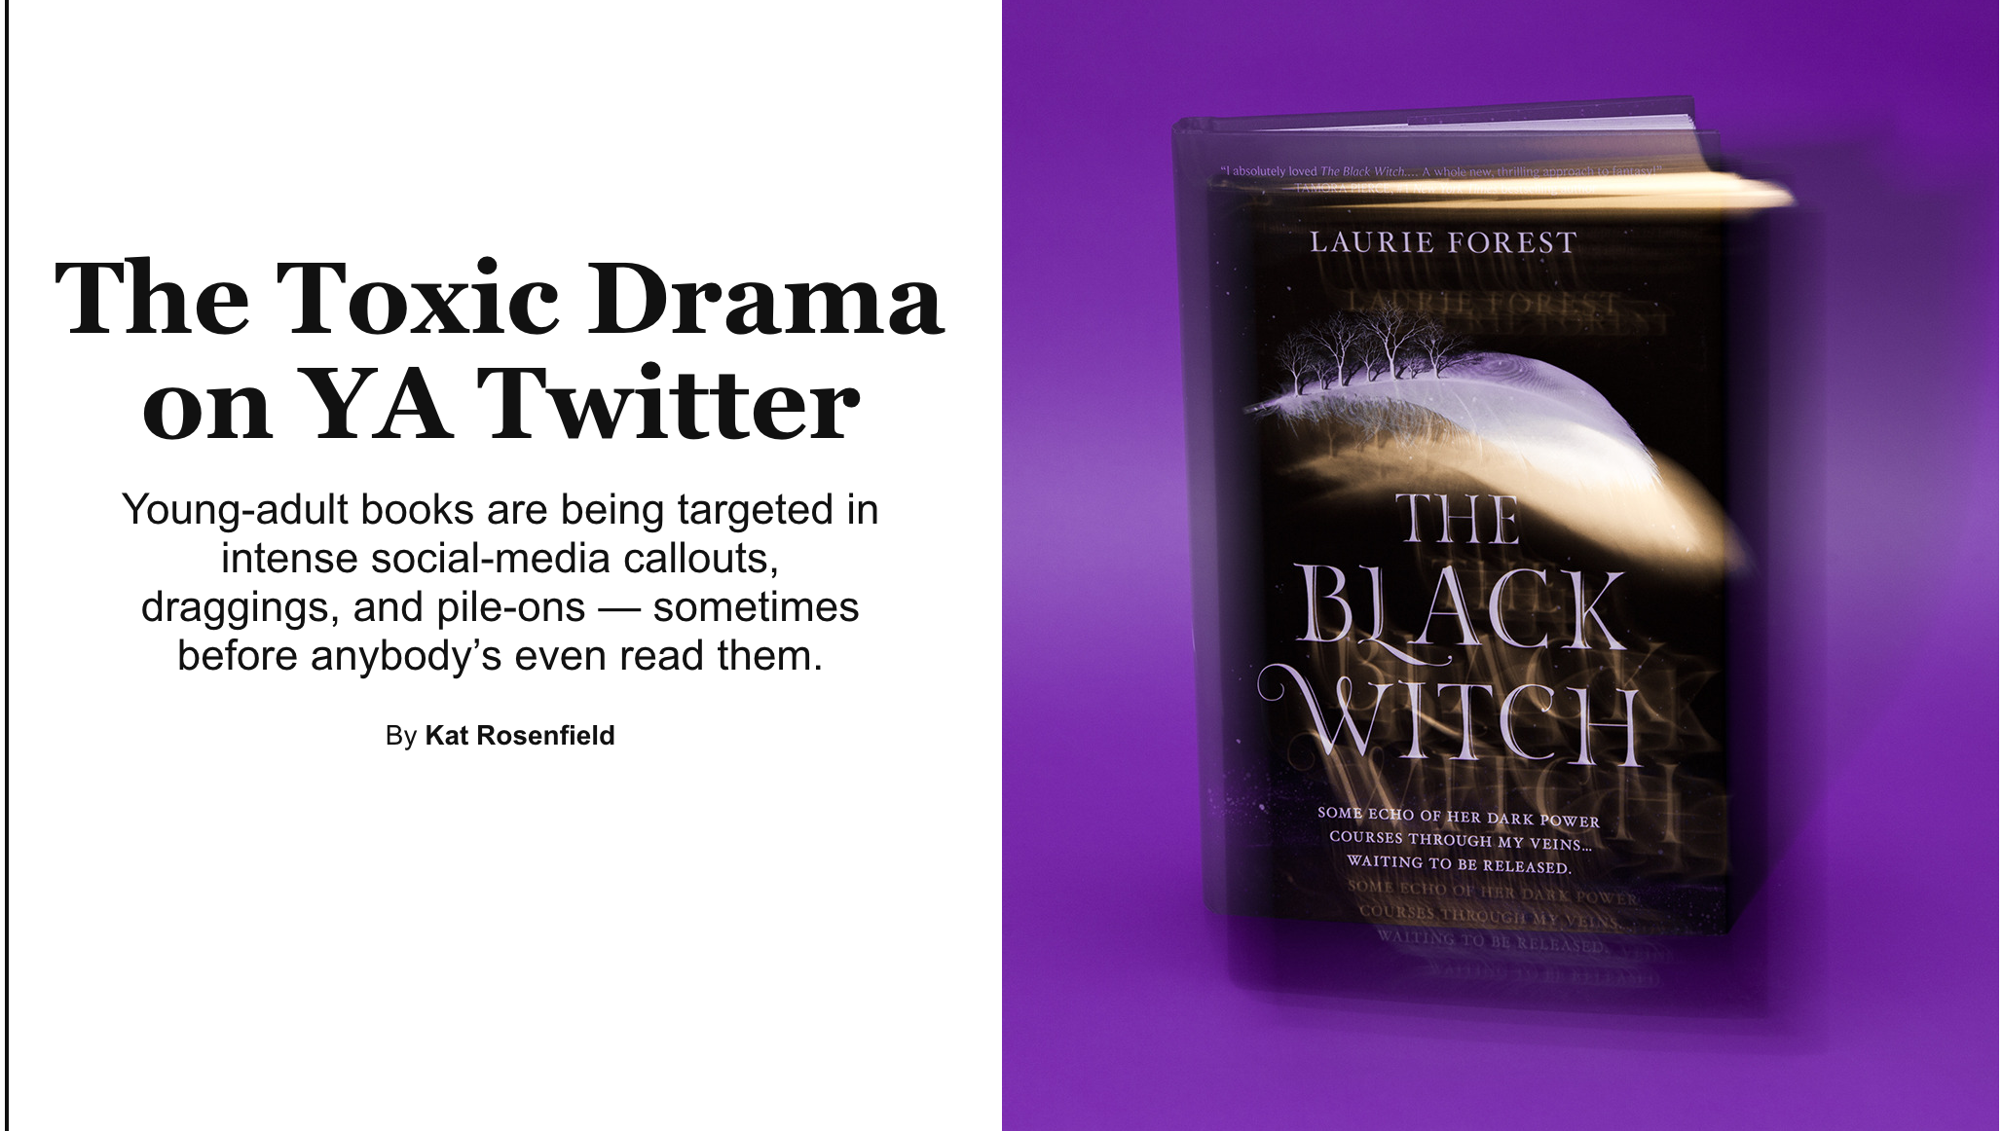
“Toxic Twitter” Controversy

Slide 17
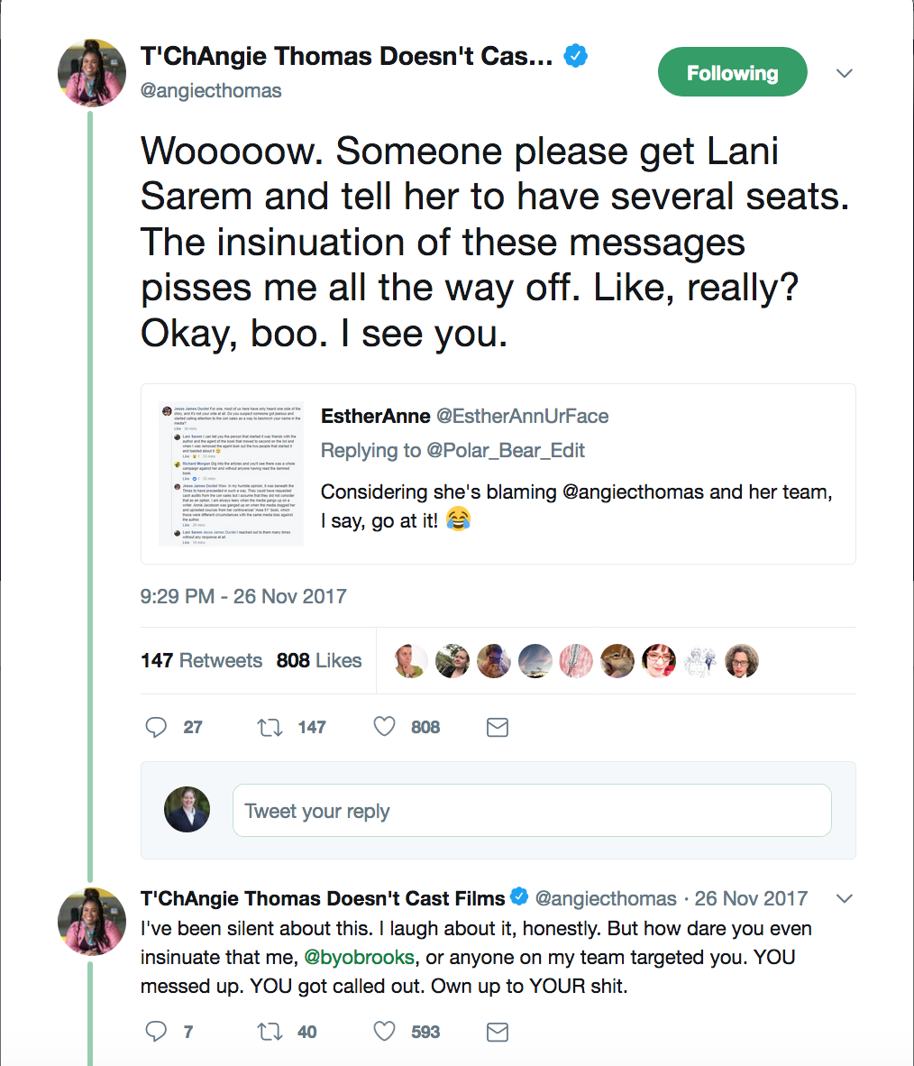
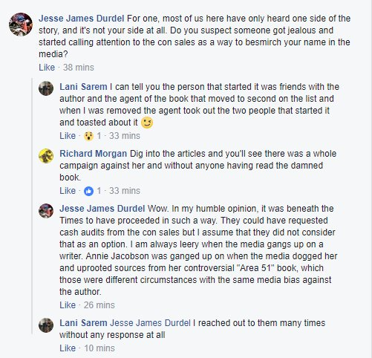
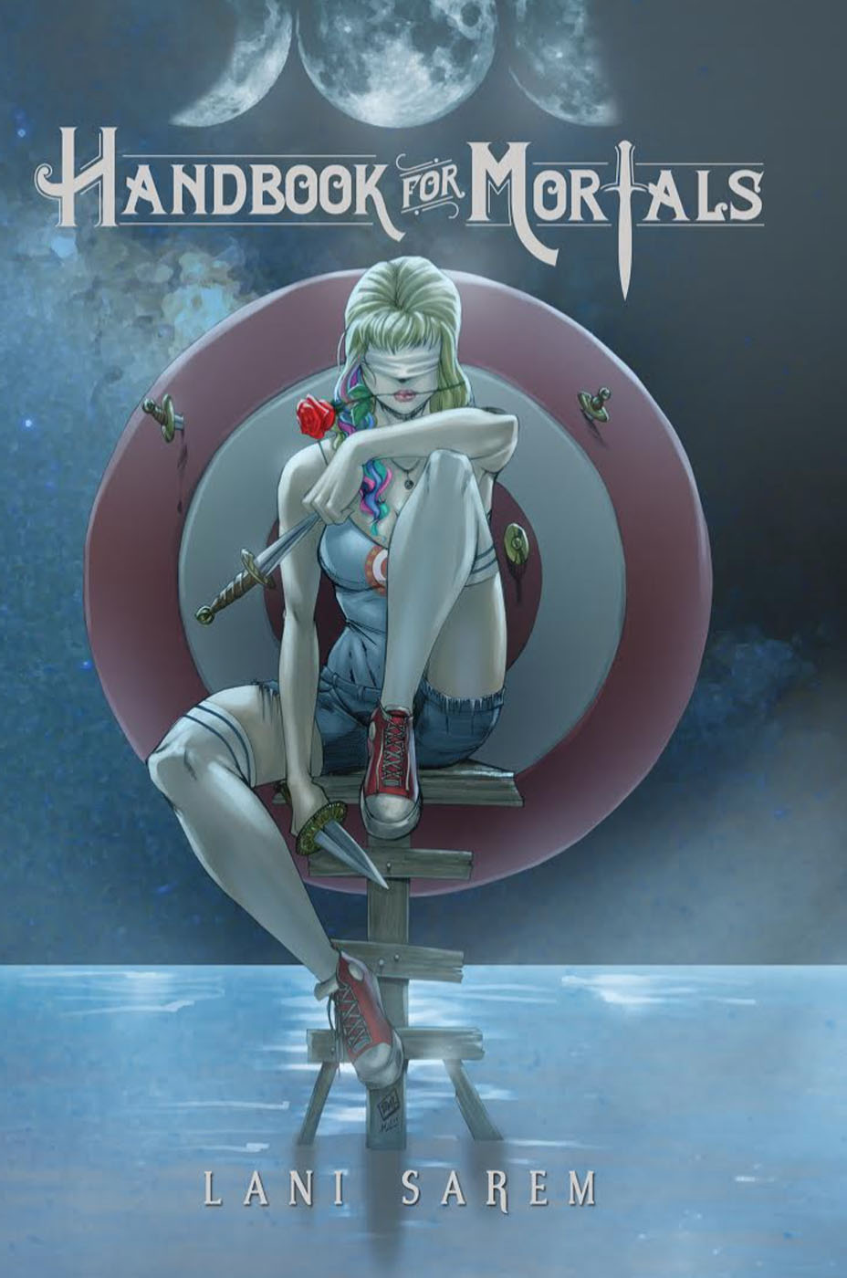
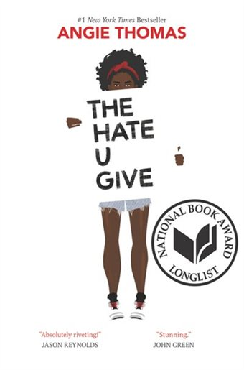
Sarem vs Thomas

Slide 18
Conclusions
Y’all, I am out of pretty graphics

Slide 19
Best sellers get film deals
The YA List is vulnerable
The “hive mind” is mighty
Best seller lists are neither objective, nor infallible
Best seller lists affect what gets read, purchased and made into movies

Slide 20
Special thanks:
Liz Holdsworth and
Karen Viars (@karenviars) at Georgia Tech
Fabulous co-authors! Librarians extraordinaire!

Slide 21
Thank you!
Questions? Comments?
@DrFitzPhd
Rebekah.Fitzsimmons@lmc.gatech.edu

Slide 22
Selected Works Cited
Bear, John. The #1 New York Times Bestseller: Intriguing Facts About the 484 Books That Have Been #1 New York Times Bestsellers Since the First List in 1942. Ten Speed Press, 1992.
Bercovici, Jeff. “Here’s How You Buy Your Way Onto the New York Times Bestsellers List.” Forbes. 22 Feb 2013 4:33pm. https://www.forbes.com/sites/jeffbercovici/2013/02/22/heres-how-you-buy-your-way-onto-the-new-york-times-bestsellers-list/#62442f363a7b.
Byers, Dylan. “N.Y. Times Keeps Cruz Off Bestseller List.” Politco, 9 July 2015, https://www.politico.com/blogs/media/2015/07/ny-times-keeps-cruz-off-bestseller-list-210254.
Charaipotra, Sona and Zoraida Córdova. “How YA Twitter is Trying to Dismantle White Supremacy, One Book at a Time.” Bustle, 18 Aug 2017. https://www.bustle.com/p/how-ya-twitter-is-trying-to-dismantle-white-supremacy-one-book-at-a-time-76946.
Deahl, Rachel. “The Bestseller Brought Down by the YA Community.” Publishers Weekly, 24 Aug 2017. https://www.publishersweekly.com/pw/by-topic/childrens/childrens-book-news/article/74592-the-ya-book-that-has-the-ya-community-crying-foul.html.
Donaldson, Kayleigh. “Updated: Did this Book Buy Its Way Onto the New York Times Bestseller List?” Pajiba. 27 Aug 2017. http://www.pajiba.com/book_reviews/did-this-book-buy-its-way-onto-the-new-york-times-bestseller-list.php.
Fallon, Claire. “‘Handbook for Mortals’ Author Accuses YA Community of Keeping Out New Voices”. The Huffington Post. 25 Aug 2017, https://www.huffingtonpost.com/entry/lani-sarem-book-of-mortals-ya-best-seller-list_us_59a04ee8e4b06d67e33750f0.
Fitzsimmons, Rebekah. “Prizing Popularity: How the Blockbuster Book Has Reshaped Children’s Literature.” Prizing Children’s Literature: The Cultural Politics of Children’s Book Awards. Ed. Kenneth Kidd and Joseph Thomas. Routledge, 2016.
---. "Testing the Tastemakers: Children’s Literature, Bestseller Lists, and the ‘Harry Potter Effect’." Children's Literature vol. 40, no. 1, 2012, pp. 78-107.
Graham, Ruth. “Against YA.” Slate. 5 June 2014, http://www.slate.com/articles/arts/books/2014/06/against_ya_adults_should_be_embarrassed_to_read_children_s_books.html.
Hughes, William. “Delve into the Mystery of Whether this YA Novel is Buying Its Way onto The NYT Bestseller List.” The AV Club. 24 Aug. 2017 https://www.avclub.com/delve-into-the-mystery-of-whether-this-ya-novel-is-buyi-1798412479.

Slide 23
Selected Works Cited
Kane, Vivian. “‘Handbook for Mortals’ Best Seller Spot Is Peak White Entitlement.” The Mary Sue. 28 Aug 2017. https://www.themarysue.com/handbook-for-mortals-hate-u-give/.
Korda, Michael. Making the List: A Cultural History of the American Bestseller, 1900- 1999. .
Lawrence, Emily. "Is Contemporary Readers' Advisory Populist?: Taste Elevation and Ideological Tension in the Genreflecting Series." Library Trends, vol. 65, no. 4, 2017, pp 491-507.
“Libraries with Cake Pans.” (2018). Retrieved from: http://www.statelibraryofiowa.org/ld/k-p/librarians/cake.
Miller, Laura J. “Best-Seller List as Marketing Tool and Historical Fiction.” Book History Vol. 3, 2000, pp. 286-304. JSTOR, http://www.jstor.org/stable/30227320.
---. “The making of a blockbuster: Salon exclusive: The behind-the-scenes story of the readers and booksellers who launched the Hunger Games franchise.” Salon. Salon Media Group. 18 March 2012. https://www.salon.com/2012/03/18/the_making_of_a_blockbuster/
Milliot, Jim. “The PW Publishing Industry Salary Survey 2015: A Younger Workforce, Still Predominantly White.” Publisher’s Weekly, 16 Oct 2015, https://www.publishersweekly.com/pw/by-topic/industry-news/publisher-news/article/68405-publishing-industry-salary-survey-2015-a-younger-workforce-still-predominantly-white.html.
NDP Bookscan. The NPD Group, 2018, https://www.npd.com/wps/portal/npd/us/home/
Pareene, Alex. “The Conservative Book Industry Isn’t Dead, It’s Just Embarrassing.” Salon, 24 March 2014. https://www.salon.com/2014/03/24/the_conservative_book_industry_isnt_dead_its_just_embarrassing/.
Rassuli, Kathleen M., and Stanley C. Hollander. "Revolving, Not Revolutionary Books: The History of Rental Libraries until 1960." Journal of Macromarketing, vol. 21, no. 2, 2001, pp. 123-134.
Ross, Catherine S. "Reader on tTop: Public Libraries, Pleasure Reading, and Models of Reading." Library Trends, vol. 57, no. 4, 2009, pp. 632-656.
Rose, Matthew. “Harry Potter Book is Breaking Records as it Tops Journal’s List of Bestsellers.” Wall Street Journal, 16 Sept 1999, https://www.wsj.com/articles/SB937442449150651305.
Rosenfeld, Kat. “The Toxic Drama on YA Twitter.” Vulture, 7 August 2017, http://www.vulture.com/2017/08/the-toxic-drama-of-ya-twitter.html.
Shapiro, Lila. “The Making (and Unmaking) of a 23-Hour New York Times Bestseller.” 29 Sept 2017, Vulture. http://www.vulture.com/2017/09/handbook-for-mortals-lani-sarem-23-hour-new-york-times-bestseller.html.
Temple, Emily. “8 Notable Attempts to Hack the New York Times Bestseller List.” Literary Hub, 26 Sept 2017, https://lithub.com/8-notable-attempts-to-hack-the-new-york-times-bestseller-list/.
Trout, Jenny. “Jealous Haters’ Book Club: Handbook for Mortals, Intro and Chapter 0: ‘The Fool’ or ‘There Must Be Something More Than This Technicolor Dream Hair Life.” Trout Nation, 28 Aug 2017. http://jennytrout.com/?p=11574.

