Slide 1

Better Learning Through Hashtags:
Building Community and Improving Discussion with Twitter
Dr. Rebekah Fitzsimmons
Georgia Institute of Technology rebekahfitzsimmons.wordpress.com
@DrFitzPhD rebekah.fitzsimmons@lmc.gatech.edu

Slide 2
Twitter in My Classrooms
Writing Through Media: Fairy Tale Adaptations (Fall 2013)
Rhetoric, Propaganda and the High Stakes of YA Dystopian Fiction
(Spring 2016, 2017)
Making the List: Best Sellers, Best Of, and Banned Books (Fall 2017)
Upcoming: The History and Rhetoric of Science Writing for Children (Spring 2018)
For more: rebekahfitzsimmons.wordpress.com

Slide 3
To Discuss Today
Livetweeting as notetaking framework
Peer feedback via Twitter
Best practices for Twitter assignments

Slide 4
Livetweeting as notetaking framework
Informality as a feature, not a bug!

Slide 5
Livetweeting
Record and share thoughts in response to a live event
    TV, live event, presentation
Stream of consciousness, in the moment responses to material
  Use hashtag (#MLA18, #Olympics18, #GameofThrones)
Aim is to entertain or engage fellow watchers while recording critical assessments
Teaching: resembles notetaking or reading journals

Slide 6
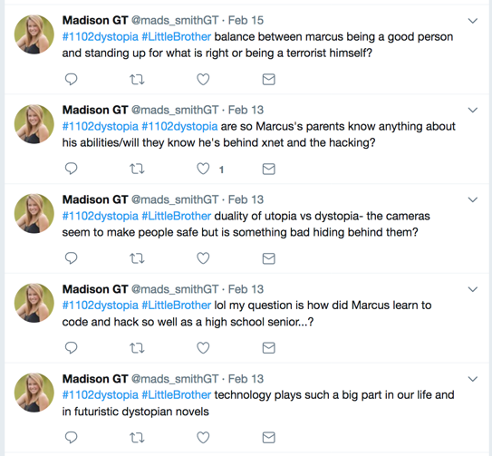
Example:*
*All student examples used with student permission

Slide 7
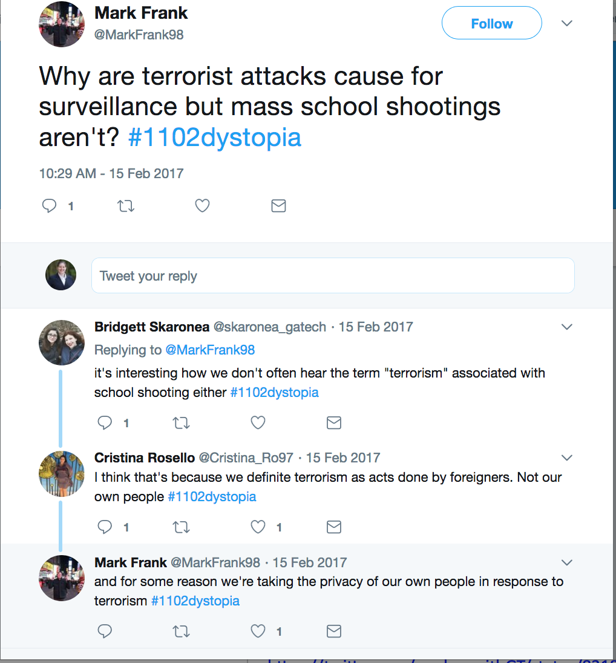
Pedagogical Implications
Audience
Digital sandbox
Collaborative brainstorming
Faculty reinforcement

Slide 8
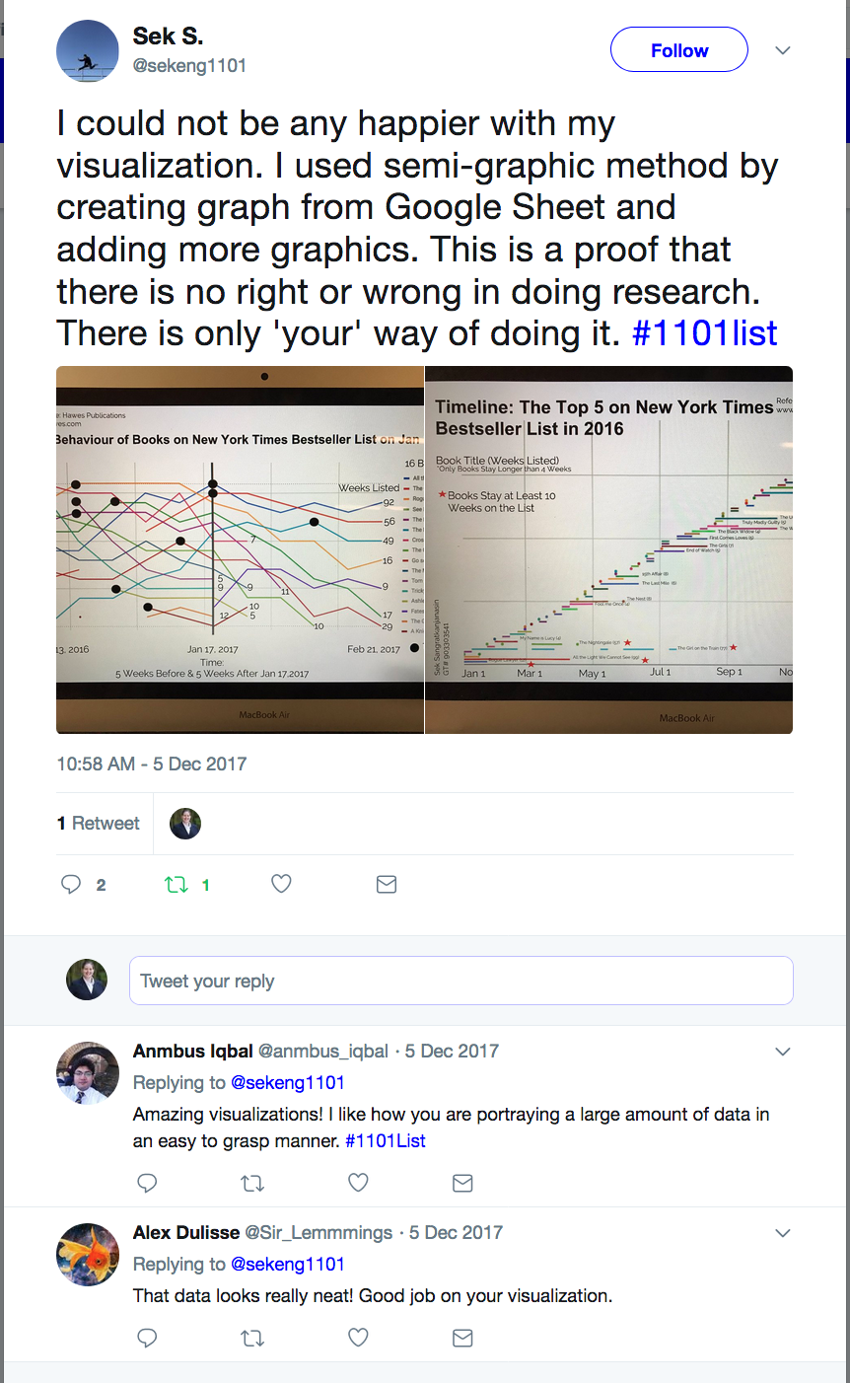
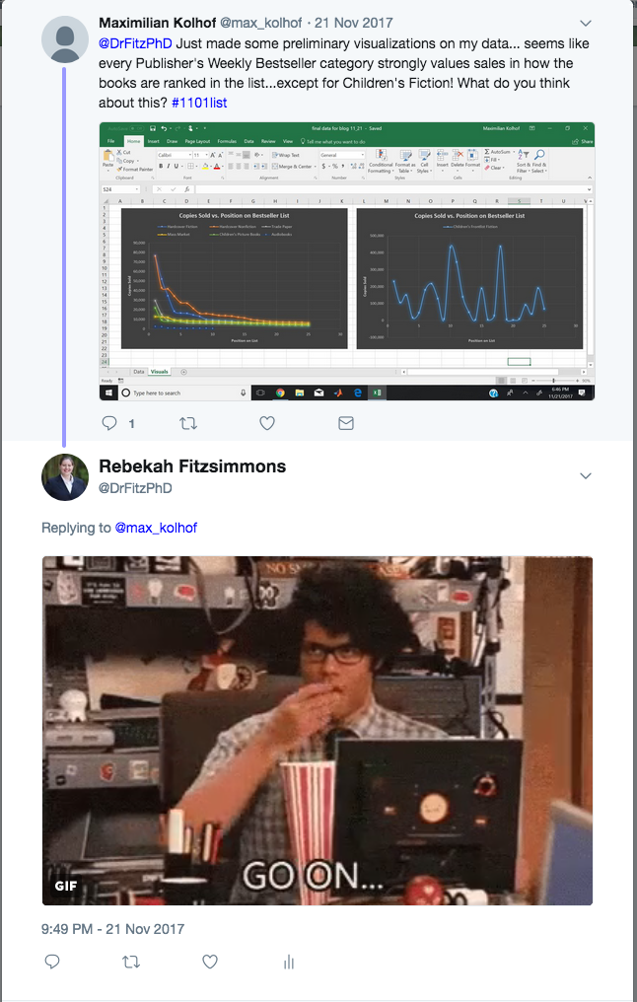
Multimodality
Images of text
Gifs
Screenshots
Drafts of work

Slide 9
Peer feedback via Twitter
Let the “social” part of social media work for your course!

Slide 10
Using the “social” in social media
Interactivity of social media is assumed
  Note taking, but with active feedback
Informal thoughts, jokes, reactions to books/films can lead to more constructive conversations, which leads to research projects
Encouragement and commiseration leads to improved community

Slide 11
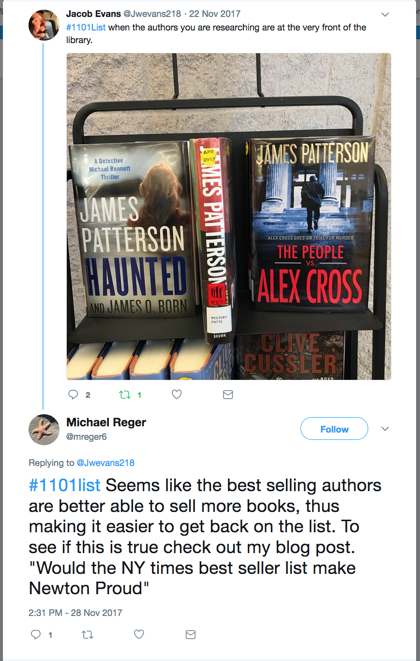
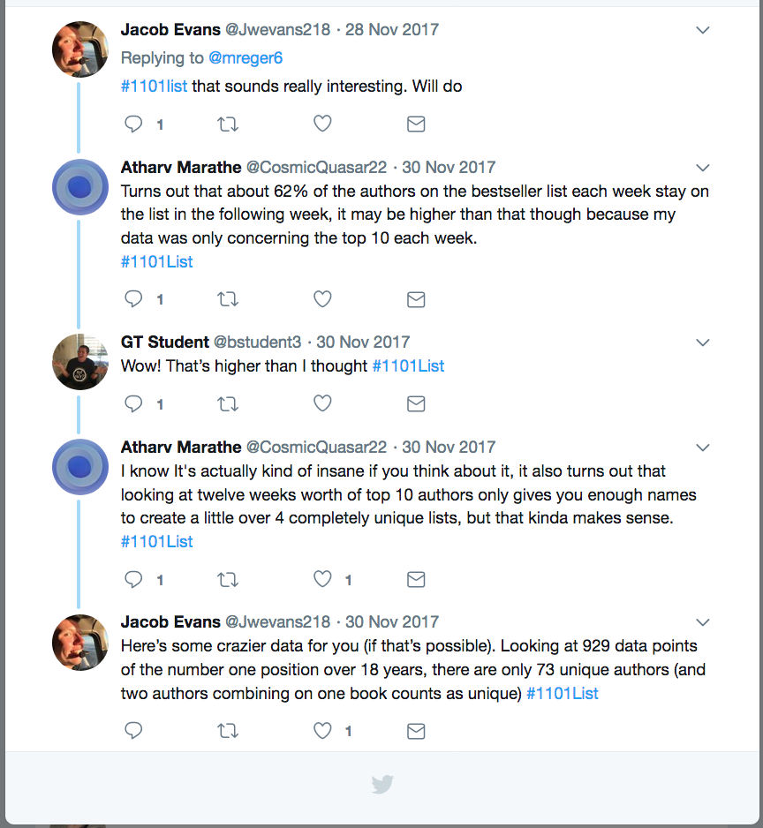
Example

Slide 12
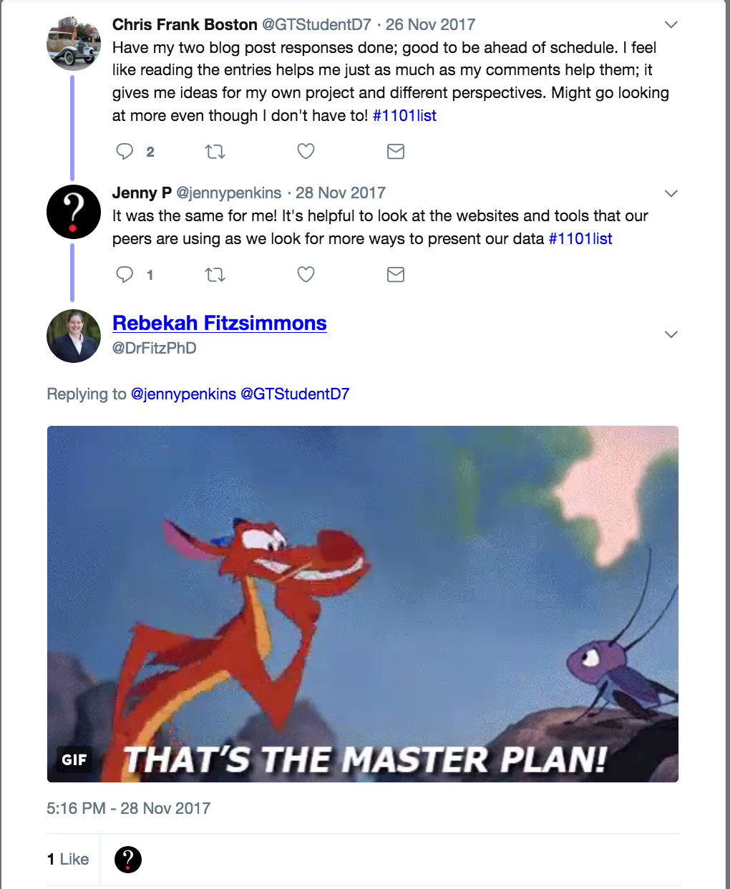
Capitalizing on social elements
Assuage digital native anxiety
Introduce Twitter features - hashtags, threads, quote tweets
Build feedback into assignments
Model positive feedback within informal conventions

Slide 13
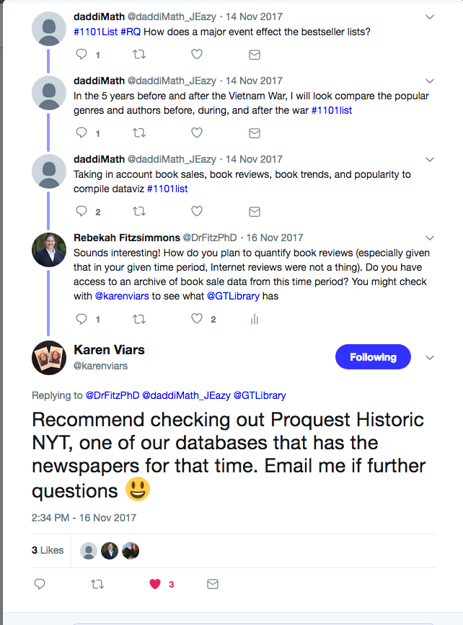
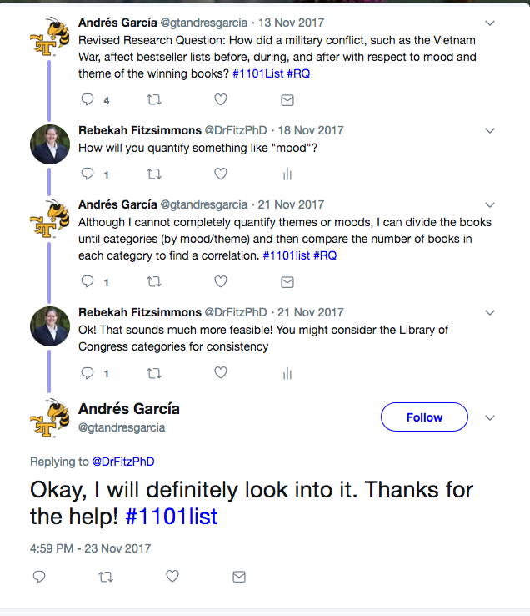

Slide 14
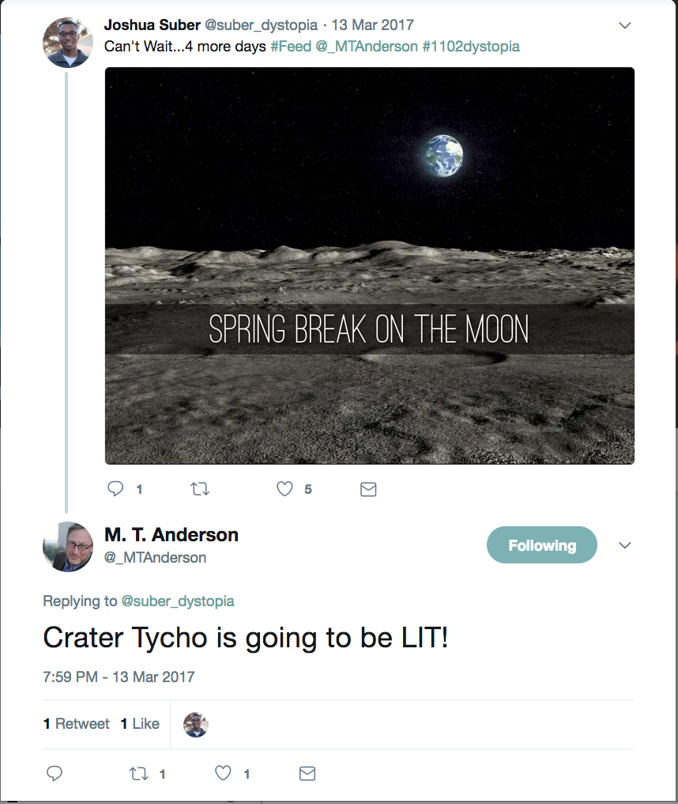
Peer Review and Beyond!
Academic twitter
Authors/Creators on Twitter
Hashtags are your friend

Slide 15
Best practices for Twitter assignments
Structuring a Social Media Component to a Comp or Lit class

Slide 16
Help Students Consider Privacy
Discuss community norms and privacy concerns FIRST
  Give students the option of an anonymous handle
Start a new Twitter account specifically for the class
  Tailor the user name, photo, and bio for privacy AND maximum effectiveness
  Curate a follow list particular to the course
  More efficient for self-evaluation and faculty assessment
NEVER NEVER give grades or protected info back via Twitter

Slide 17
Twitter Genre Conventions
Teach Twitter conventions like any other genre
  Replies on Twitter (@ versus .@)
  Threads
  Quote Tweet versus Retweet
Lesson on entering existing conversations
The more you interact, the more interaction you’ll get back

Slide 18
Minimize Anxiety
Be clear with expectations
  How many tweets?
  Twitter conventions versus English class?
  What makes a ”high quality” tweet?
Concrete instructions (5-10 tweets a week) with broad topic guidelines
  Complaints, commiseration, frustration can all be useful

Slide 19
Model Twitter Use for Students
Model the digital behavior you want to see
  Engage with scholars in your field
  Retweet relevant information for the class – articles, topic ideas
  Respond to students (office hours!)
  Livetweet your own reading/writing/work

Slide 20
Assignment Suggestions
Audience/Rhetoric of Twitter
Twitter thread to summarize reading
#FollowFriday or #ScholarSunday tweets
Improve/augment discussion:
Fishbowl with livetweet component
Tweet discussion questions before class
Peer Review Feedback:
Presentations with livetweet peer review
Twitter Research Journals with required responses
Research/Writing Process
Livetweet readings
Twitter Research Journal

Slide 21
Thank you!
Dr. Rebekah Fitzsimmons
Georgia Institute of Technology rebekahfitzsimmons.wordpress.com
@DrFitzPhD rebekah.fitzsimmons@lmc.gatech.edu

